Slide 1


Noida Institute of Engineering and Technology, Greater Noida
Unit 4
Numerical Techniques
Unit: 4
Sub Name: Optimization And Numerical Techniques
Subject Code: AAS0404
Dr. Kunti Mishra
Department of
Mathematics
B Tech 4th Sem

Slide 2
Brief Introduction of Faculty
Dr. Kunti Mishra
Assistant Professor
Department of Mathematics
Qualifications :
M.Sc.(Maths), M. Tech.(Gold Medalist) in Applied and Computational Mathematics, Ph.D
Ph.D. Thesis : Some Investigations in Fractal Theory
International Journal Publications: 7
International Conference Papers: 7
Area of Interests: Fixed Point Theory, Fractals
Teaching Experience: 5 years

Slide 3

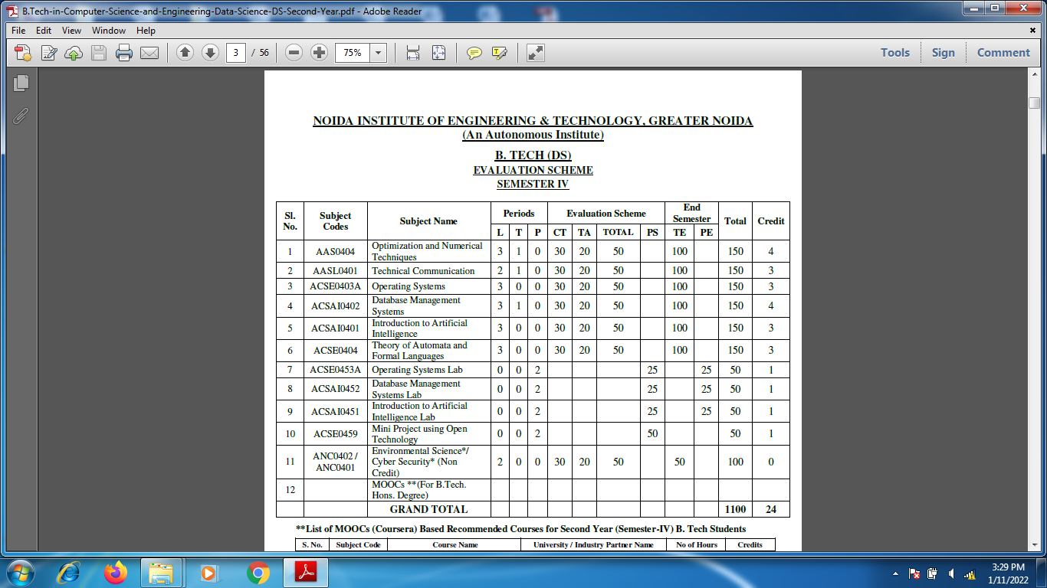
Evaluation Scheme

Slide 4
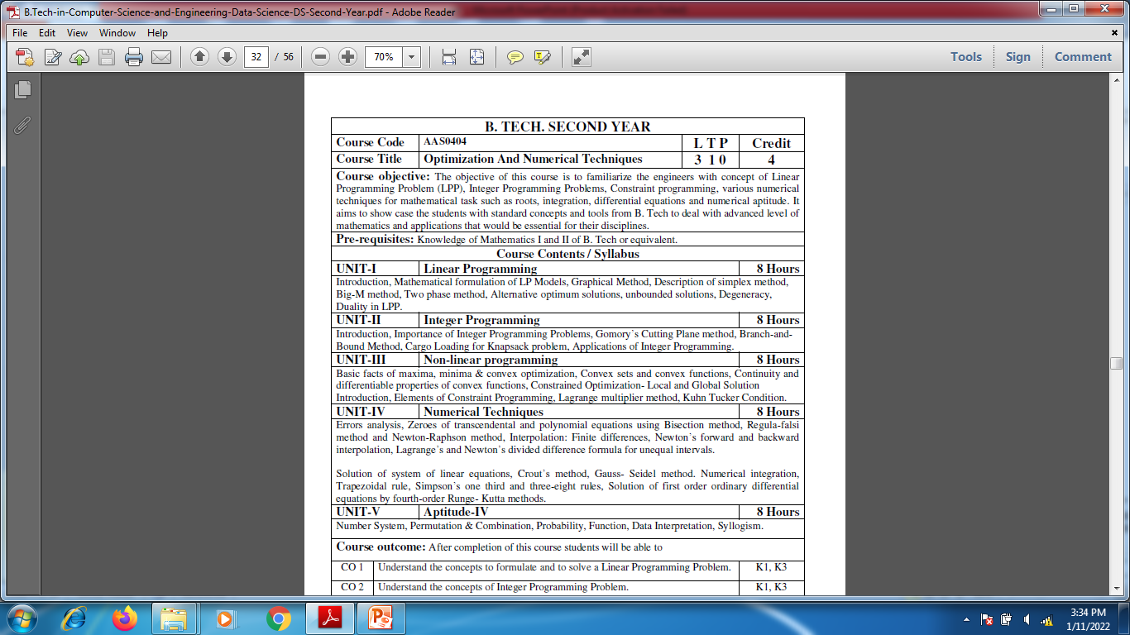
Syllabus

Slide 5

Branch wise Application
Data Analysis
Artificial intelligence
Network and Traffic modeling

Slide 6
Course Objective
Course objective: The objective of this course is to familiarize the engineers with concept of Linear Programming Problem (LPP), Integer Programming Problems, Constraint programming, various numerical techniques for mathematical task such as roots, integration, differential equations and numerical aptitude. It aims to show case the students with standard concepts and tools from B. Tech to deal with advanced level of mathematics and applications that would be essential for their disciplines. The student will be able to understand:
The concept of Linear Programming Problem .
The concept of Integer Programming Problems.
The concept of Non-Linear Programming Problem .
The concept of Numerical Techniques.
The concept of Numerical aptitude.

Slide 7
Course Outcomes
CO 1: Understand the concepts to formulate and to solve a Linear Programming Problem .
CO 2: Understand the concepts of Integer Programming Problem.
CO 3: Understand the concepts of Non- Linear Programming Problem .
CO 4: Apply the concept of numerical techniques to evaluate the zeroes of the equation, concept of interpolation and numerical methods for various mathematical operations and tasks, such as integration, the solution of linear system of equations and the solution of differential equation.
CO 5: Solve the problems of Number System, Permutation & Combination, Probability, Function, Data Interpretation, Syllogism.

Slide 8
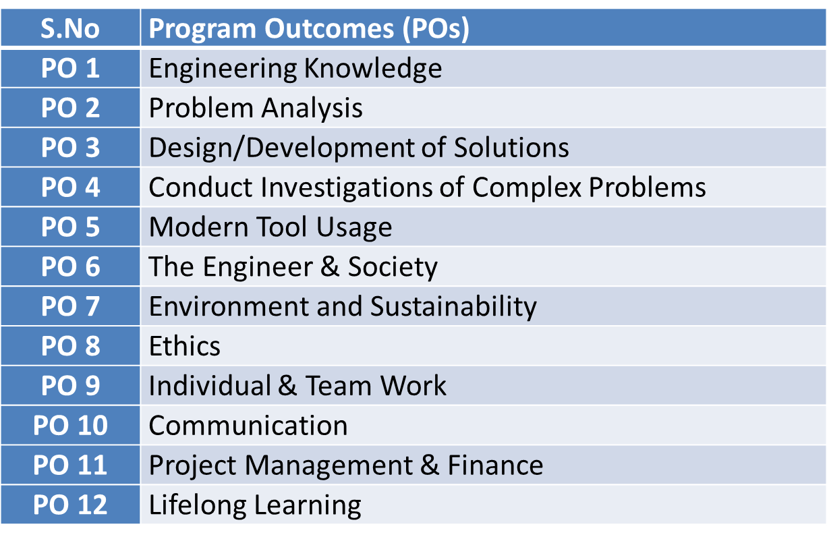
Program Outcomes

Slide 9
CO-PO Mapping(CO-4)
Sr. No | Course Outcome | PO1 | PO2 | PO3 | PO4 | PO5 | PO6 | PO7 | PO8 | PO9 | PO10 | PO11 | PO12
1 | CO1 | H | H | H | H | L | L | L | L | L | L | L | M
2 | CO-2 | H | H | H | H | L | L | L | L | L | L | M | M
3 | CO-3 | H | H | H | H | L | L | L | L | L | L | M | M
4 | CO-4 | H | H | H | H | L | L | L | L | L | L | L | M
5 | CO5 | H | H | H | H | L | L | L | L | L | L | M | M
*L= Low *M= Medium *H= High

Slide 10
PSO
PSO | Program Specific Outcomes(PSOs)
PSO1 | The ability to identify, analyze real world problems and design their ethical solutions using artificial intelligence, robotics, virtual/augmented reality, data analytics, block chain technology, and cloud computing
PSO2 | The ability to design and develop the hardware sensor devices and related interfacing software systems for solving complex engineering problems.
PSO3 | The ability to understand inter disciplinary computing techniques and to apply them in the design of advanced computing.
PSO4 | The ability to conduct investigation of complex problem with the help of technical, managerial, leadership qualities, and modern engineering tools provided by industry sponsored laboratories.

Slide 11
CO-PSO Mapping(CO-4)
CO | PSO1 | PSO2 | PSO3 | PSO4
CO.1 | H | L | M | L
CO.2 | L | M | L | M
CO.3 | M | M | M | M
CO.4 | H | M | M | M
CO.5 | H | M | M | M
*L= Low *M= Medium *H= High

Slide 12
Program Educational Objectives(PEOs)
PEO-1: To have an excellent scientific and engineering breadth so as to comprehend, analyze, design and provide sustainable solutions for real-life problems using state-of-the-art technologies.
PEO-2: To have a successful career in industries, to pursue higher studies or to support entrepreneurial endeavors and to face the global challenges.
PEO-3: To have an effective communication skills, professional attitude, ethical values and a desire to learn specific knowledge in emerging trends, technologies for research, innovation and product development and contribution to society.
PEO-4: To have life-long learning for up-skilling and re-skilling for successful professional career as engineer, scientist, entrepreneur and bureaucrat for betterment of society.

Slide 13
Result Analysis

Slide 14
End Semester Question Paper templet

Slide 15
Unit Content(CO4)
In previous lectures we have discussed-
Algebraic and transcendental equation
Bisection method
Regula falsi method
Newton raphson method
Order of convergence
Interpolation for equal intervals
Newton Forward interpolation formula
Newton Backward interpolation formula
Interpolation for unequal intervals
Lagrange’s interpolation formula
Newton divided difference interpolation formula

Slide 16
Unit Content(CO4)
Algebraic and transcendental equation
Bisection method
Regula falsi method
Newton raphson method
Order of convergence
Interpolation for equal intervals
Newton Forward interpolation formula
Newton Backward interpolation formula
Interpolation for unequal intervals
Lagrange’s interpolation formula
Newton divided difference interpolation formula

Slide 17
Unit Objective(CO4)
In this unit, we will Apply numerical methods to obtain approximate solutions to mathematical problems. We will study numerical methods for various mathematical operations and tasks, such as interpolation, differentiation, integration, the solution of linear and nonlinear equations, and the solution of differential equations.

Slide 18
Prerequisite(CO4)
Solution of algebraic equation
Differentiation
Integration
Definite integral

Slide 19
Topic Objectives[CO4]
To study Iterative method for finding approximate root of algebraic or transcendental equations.

Slide 20
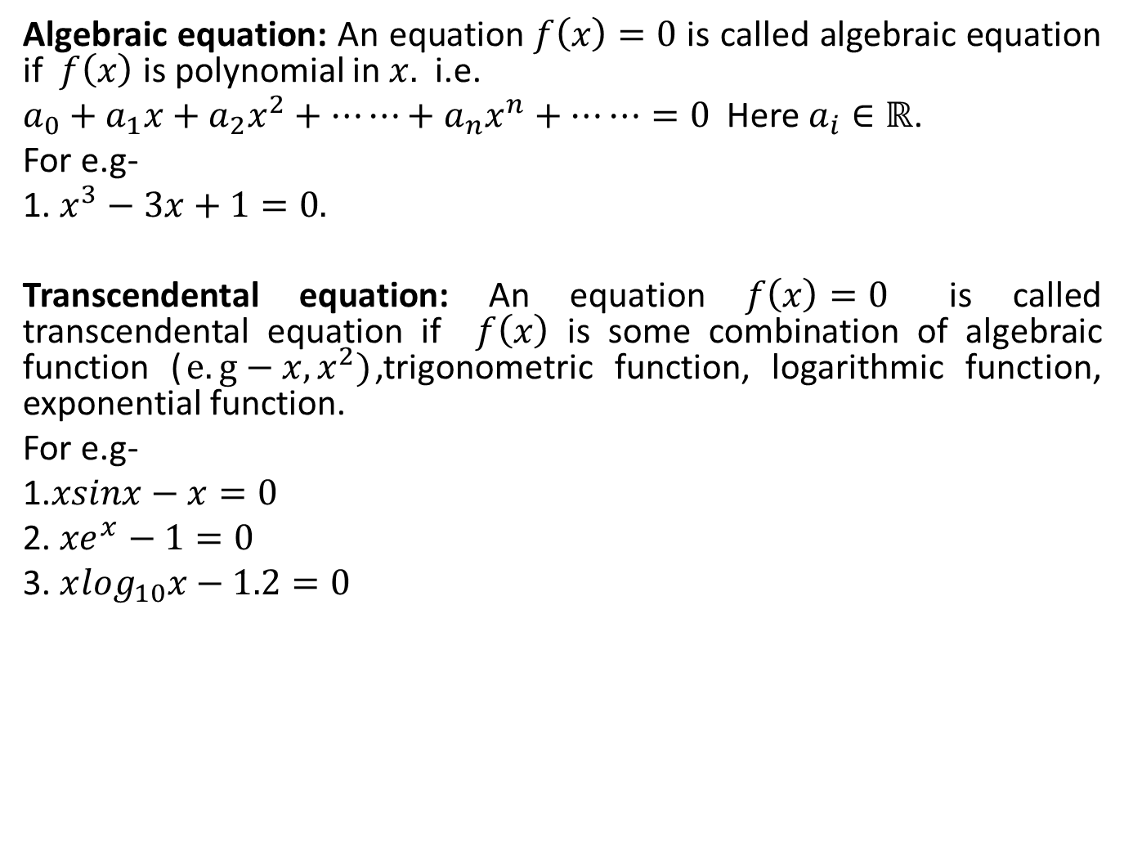
Zeroes of transcendental and algebraic equations[CO4]
Algebraic equation: An equation $f\left(x\right)=0$ is called algebraic equation if $f\left(x\right)$ is polynomial in $x.$ i.e.
$a_{0}+a_{1}x+a_{2}x^{2}+⋯⋯+a_{n}x^{n}+⋯⋯=0$Here $a_{i}∈ℝ$.
For e.g-
1. $x^{3}−3x+1=0.$
Transcendental equation: An equation $f\left(x\right)=0$ is called transcendental equation if $f\left(x\right)$ is some combination of algebraic function ($e.g−{x,x}^{2})$,trigonometric function, logarithmic function, exponential function.
For e.g-
1.$xsinx−x=0$
2. ${xe}^{x}−1=0$
3. $x\log_{10}x−1.2=0$

Slide 21
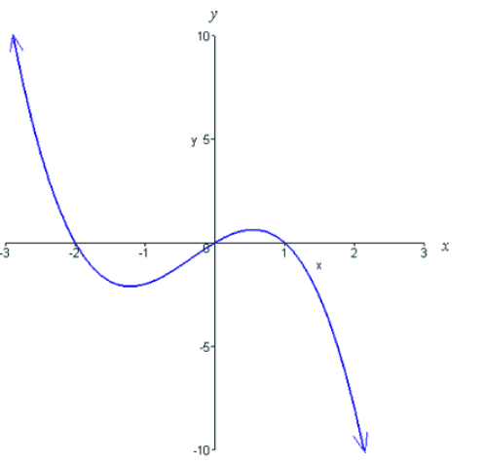
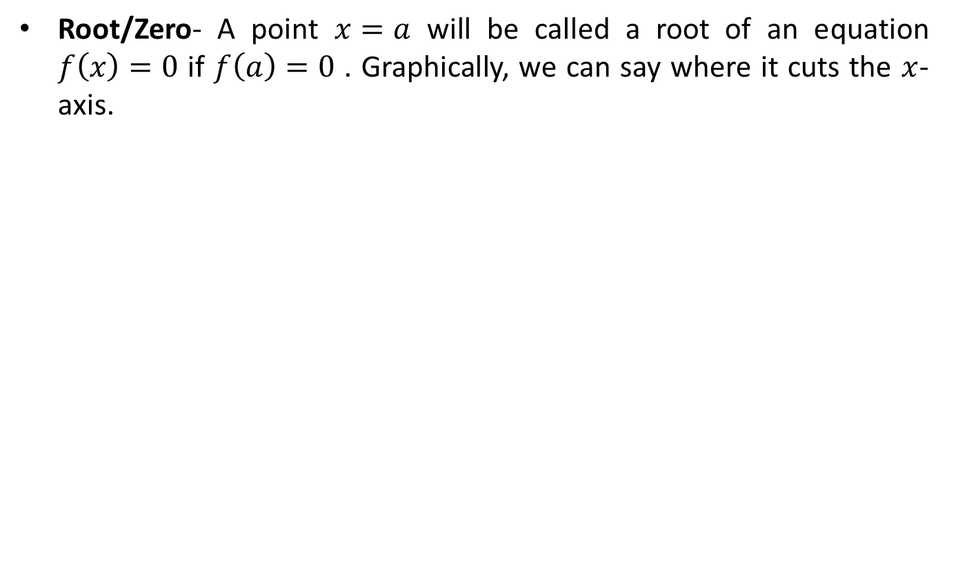
Zeroes of transcendental and polynomial equations[CO4]
Root/Zero- A point $x=a$ will be called a root of an equation $f\left(x\right)=0$ if $f\left(a\right)=0$ . Graphically, we can say where it cuts the $x$-axis.

Slide 22
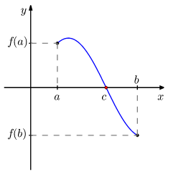
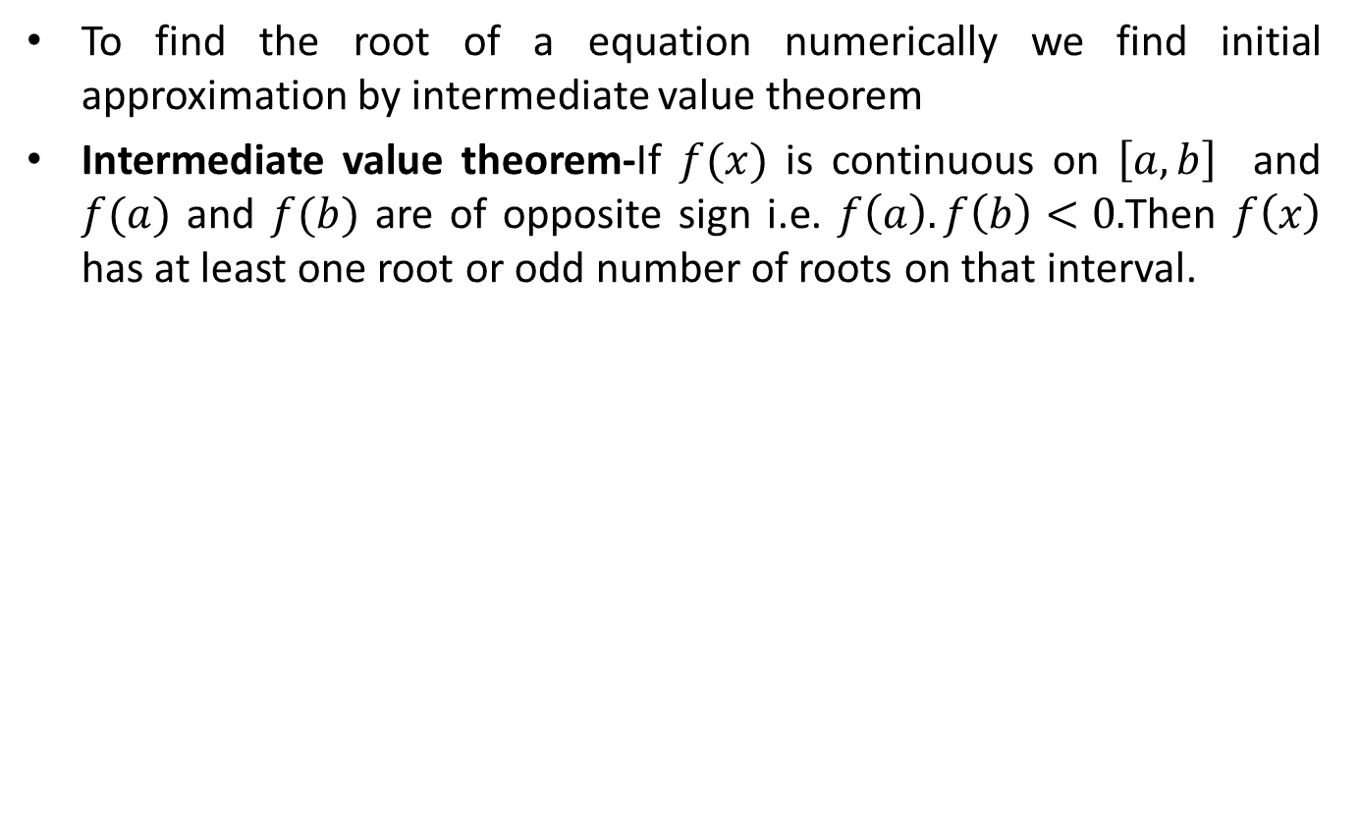
Zeroes of transcendental and polynomial equations[CO4]
To find the root of a equation numerically we find initial approximation by intermediate value theorem
Intermediate value theorem-If $f(x)$ is continuous on $\left[a,b\right]$ and $f(a)$ and $f(b)$ are of opposite sign i.e. $f\left(a\right).f\left(b\right)<0.$Then $f\left(x\right)$ has at least one root or odd number of roots on that interval.

Slide 23
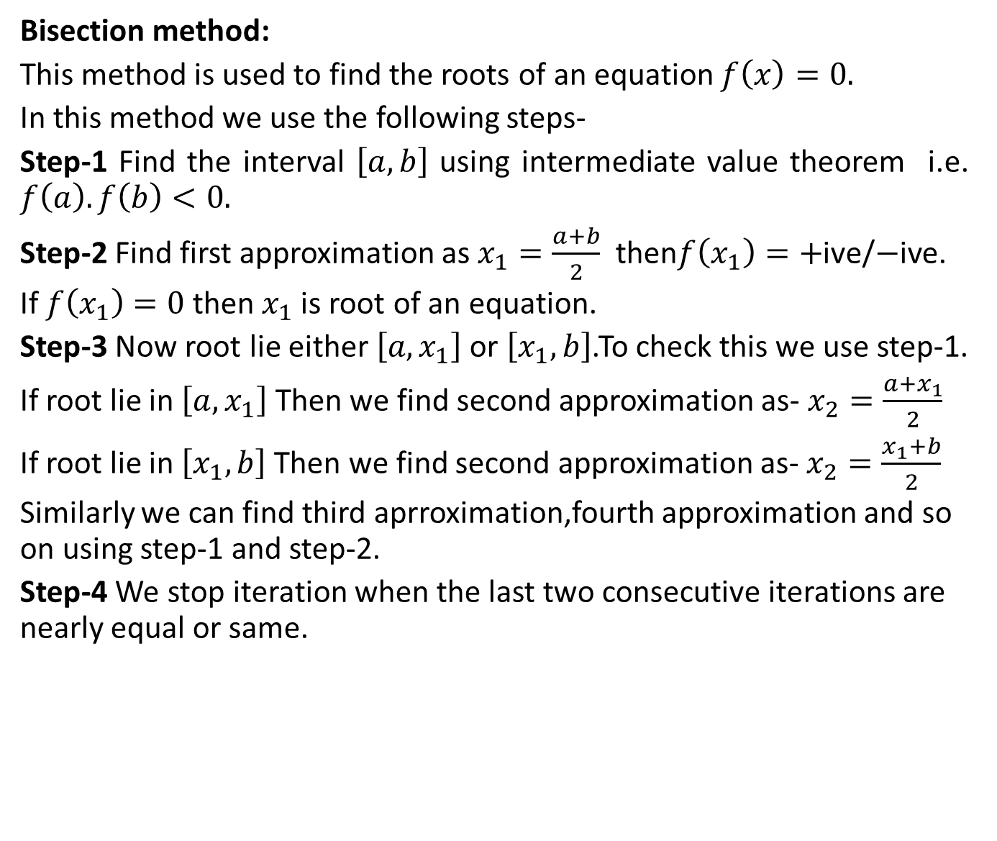
Bisection method[CO4]
Bisection method:
This method is used to find the roots of an equation $f\left(x\right)=0.$
In this method we use the following steps-
Step-1 Find the interval $\left[a,b\right]$ using intermediate value theorem i.e. $f\left(a\right).f\left(b\right)<0.$
Step-2 Find first approximation as $x_{1}=\frac{a+b}{2}$ then$f\left(x_{1}\right)=+$ive/$−$ive.
If $f\left(x_{1}\right)=0$ then${ x}_{1}$is root of an equation.
Step-3 Now root lie either $\left[a,x_{1}\right]$ or $\left[x_{1},b\right]$.To check this we use step-1.
If root lie in $\left[a,x_{1}\right]$ Then we find second approximation as- $x_{2}=\frac{a+x_{1}}{2}$
If root lie in $\left[x_{1},b\right]$Then we find second approximation as- $x_{2}=\frac{x_{1}+b}{2}$
Similarly we can find third aprroximation,fourth approximation and so on using step-1 and step-2.
Step-4 We stop iteration when the last two consecutive iterations are nearly equal or same.

Slide 24
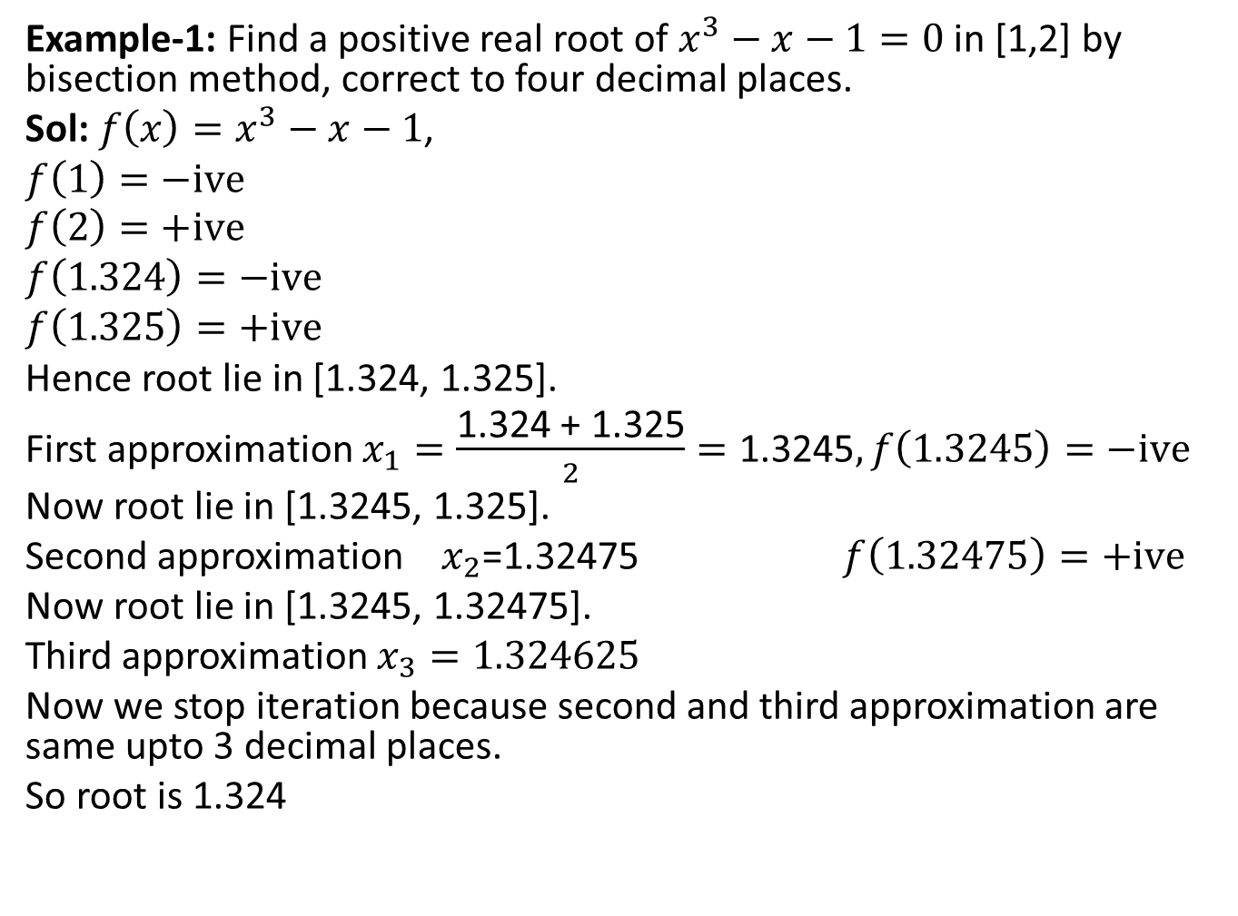
Bisection method[CO4]
Example-1: Find a positive real root of $x^{3}−x−1=0$in [1,2] by bisection method, correct to four decimal places.
Sol:$f\left(x\right)=x^{3}−x−1$,
$$f\left(1\right)=−ive$$
$$f\left(2\right)=+ive$$
$$f\left(1.324\right)=−ive$$
$$f\left(1.325\right)=+ive$$
Hence root lie in [1.324, 1.325].
First approximation $x_{1}=\frac{\text{1.324}\text{ + }\text{1.325}}{2}=\text{1.3245},f\left(1.3245\right)=−ive$
Now root lie in [1.3245, 1.325].
Second approximation $x_{2}$=1.32475 $f\left(1.32475\right)=+ive$
Now root lie in [1.3245, 1.32475].
Third approximation $x_{3}=1.324625$
Now we stop iteration because second and third approximation are same upto 3 decimal places.
So root is 1.324

Slide 25
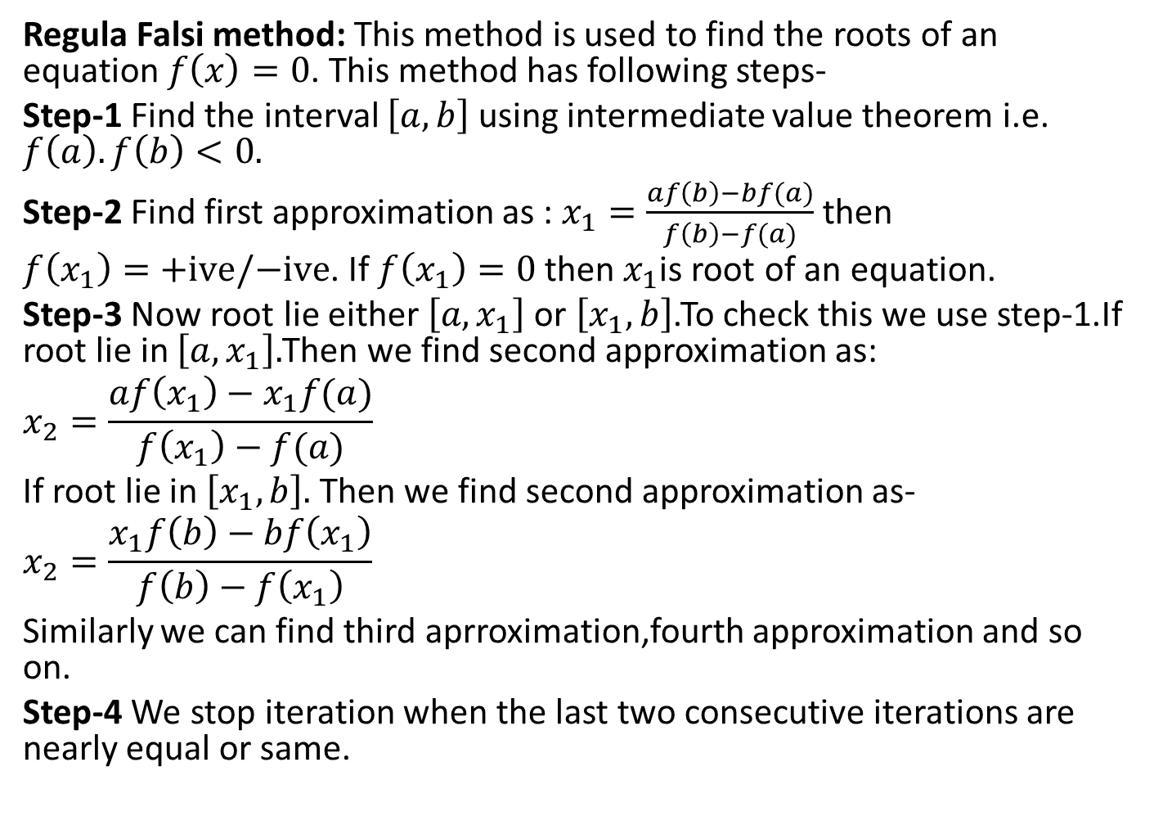
Regula Falsi method/Method of false position[CO4]
Regula Falsi method: This method is used to find the roots of an equation $f\left(x\right)=0$. This method has following steps-
Step-1 Find the interval $\left[a,b\right]$ using intermediate value theorem i.e. $f\left(a\right).f\left(b\right)<0.$
Step-2 Find first approximation as : $x_{1}=\frac{af\left(b\right)−bf(a)}{f\left(b\right)−f(a)}$then
$f\left(x_{1}\right)=+ive/−ive$. If $f\left(x_{1}\right)=0$ then${ x}_{1}$is root of an equation.
Step-3 Now root lie either $\left[a,x_{1}\right]$ or $\left[x_{1},b\right]$.To check this we use step-1.If root lie in $\left[a,x_{1}\right].$Then we find second approximation as:
$$x_{2}=\frac{af\left(x_{1}\right)−x_{1}f(a)}{f\left(x_{1}\right)−f(a)}$$
If root lie in $\left[x_{1},b\right].$ Then we find second approximation as-
$$x_{2}=\frac{x_{1}f\left(b\right)−bf\left(x_{1}\right)}{f\left(b\right)−f\left(x_{1}\right)}$$
Similarly we can find third aprroximation,fourth approximation and so on.
Step-4 We stop iteration when the last two consecutive iterations are nearly equal or same.

Slide 26
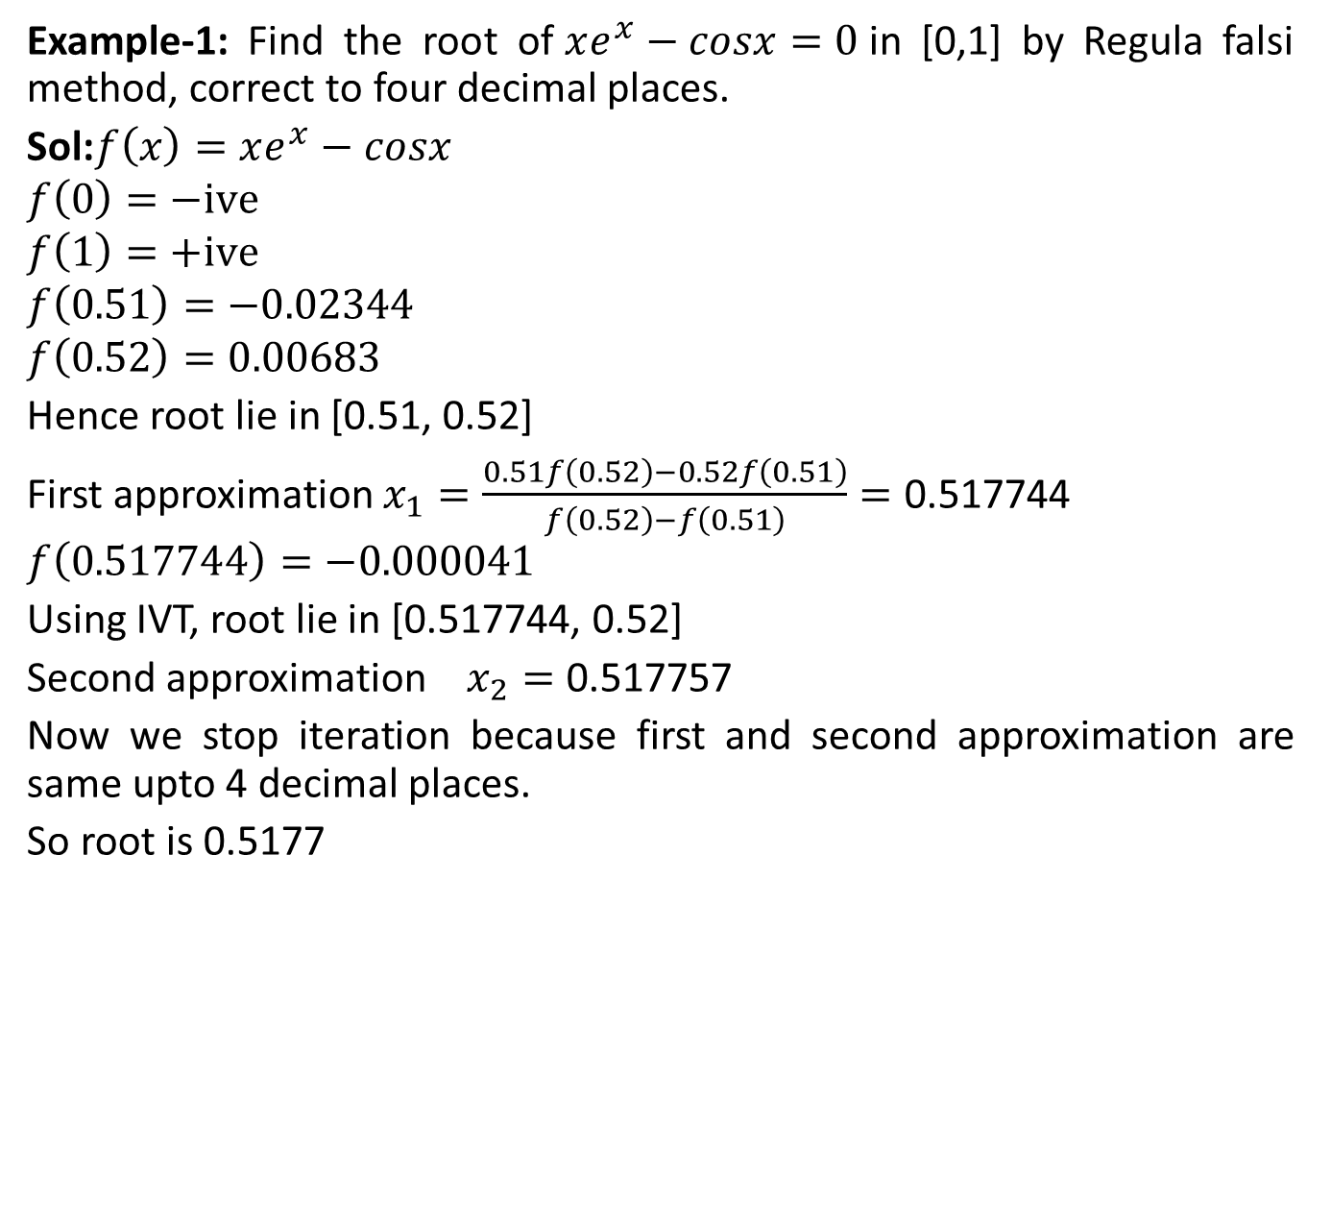
Regula Falsi method[CO4]
Example-1: Find the root of$xe^{x}−cosx=0$in [0,1] by Regulafalsi method, correct to four decimal places.
Sol:$f\left(x\right)=xe^{x}−cosx$
$$f\left(0\right)=−ive$$
$$f\left(1\right)=+ive$$
$$f\left(0.51\right)=−0.02344$$
$$f\left(0.52\right)=0.00683$$
Hence root lie in [0.51, 0.52]
First approximation $x_{1}=\frac{0.51f\left(0.52\right)−0.52f\left(0.51\right)}{f\left(0.52\right)−f\left(0.51\right)}=\text{0.517744}$
$$f\left(0.517744\right)=−0.000041$$
Using IVT, root lie in [0.517744, 0.52]
Second approximation $x_{2}=\text{0.517757}$
Now we stop iteration because first and second approximation are same upto 4 decimal places.
So root is 0.5177

Slide 27
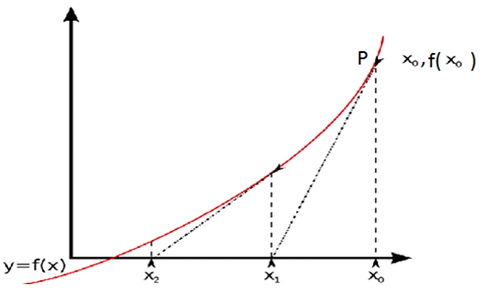
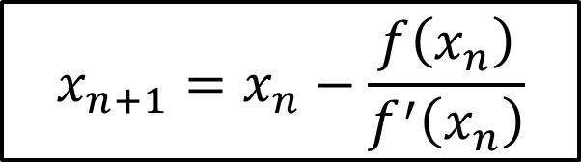
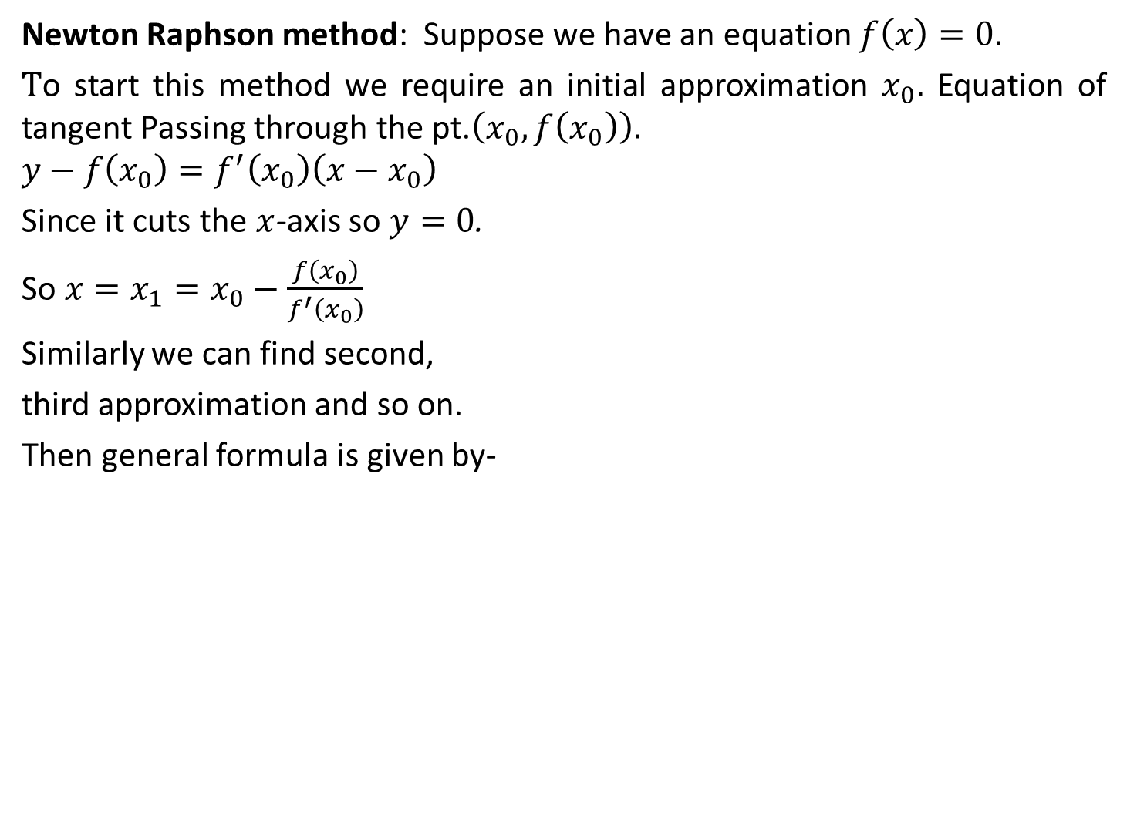
Newton Raphson method[CO4]
Newton Raphson method: Suppose we have an equation $f\left(x\right)=0.$
$T$o start this method we require an initial approximation $x_{0}.$ Equation of tangent Passing through the pt.$\left(x_{0},f\left(x_{0}\right)\right).$
$$y−f\left(x_{0}\right)=f^{′}\left(x_{0}\right)\left(x−x_{0}\right)$$
Since it cuts the $x$-axis so $y=0$.
So $x=x_{1}=x_{0}−\frac{f\left(x_{0}\right)}{f^{′}\left(x_{0}\right)}$
Similarly we can find second,
third approximation and so on.
Then general formula is given by-
$$x_{n+1}=x_{n}−\frac{f\left(x_{n}\right)}{f^{′}\left(x_{n}\right)}$$

Slide 28
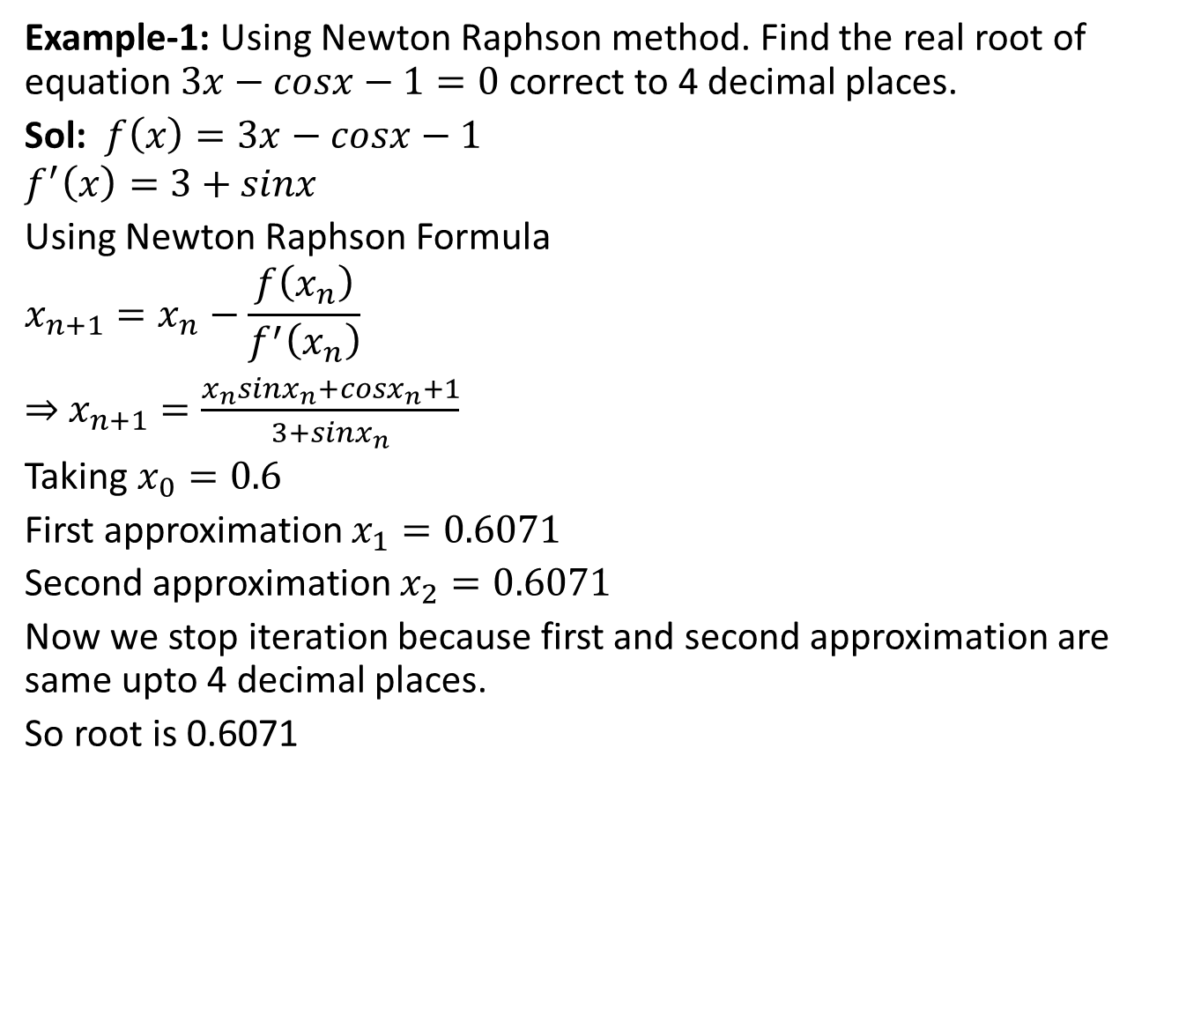
Newton Raphson method[CO4]
Example-1: Using Newton Raphson method. Find the real root of equation $3x−cosx−1=0$ correct to 4 decimal places.
Sol: $f\left(x\right)=3x−cosx−1$
$$f^{′}\left(x\right)=3+sinx$$
Using Newton Raphson Formula
$$x_{n+1}=x_{n}−\frac{f\left(x_{n}\right)}{f^{′}\left(x_{n}\right)}$$
⇒ $x_{n+1}=\frac{x_{n}sinx_{n}+cosx_{n}+1}{3+sinx_{n}}$
Taking $x_{0}=0.6$
First approximation $x_{1}=0.6071$
Second approximation $x_{2}=0.6071$
Now we stop iteration because first and second approximation are same upto 4 decimal places.
So root is 0.6071

Slide 29
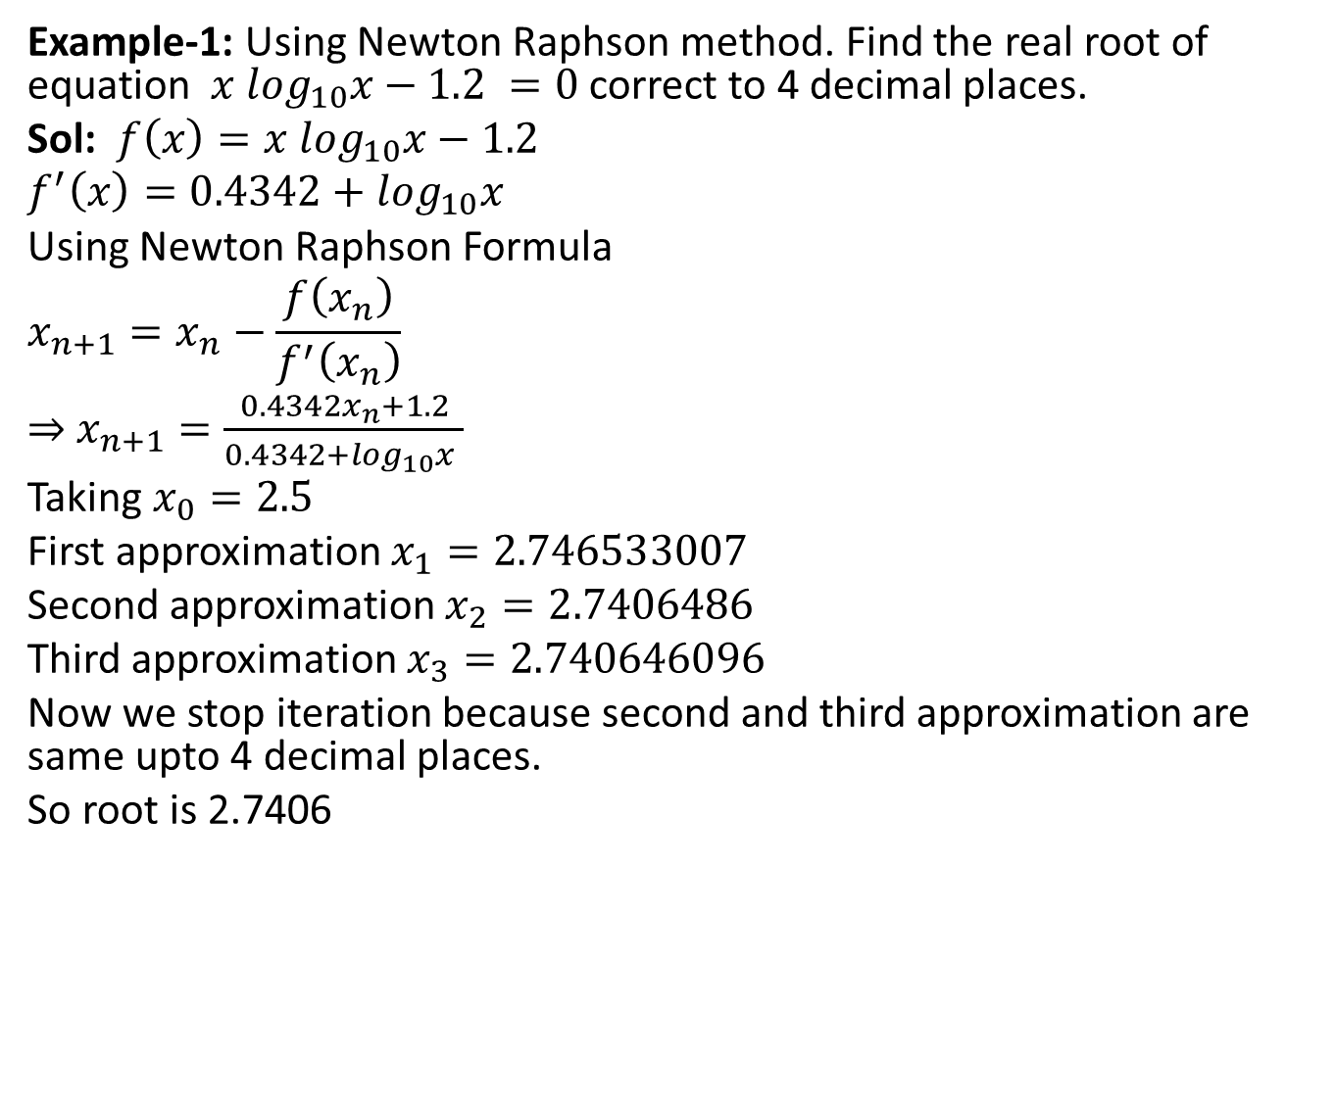
Newton Raphson method[CO4]
Example-1: Using Newton Raphson method. Find the real root of equation $x \log_{10}x−1.2 =0$ correct to 4 decimal places.
Sol: $f\left(x\right)=x \log_{10}x−1.2$
$$f^{′}\left(x\right)=0.4342+\log_{10}x$$
Using Newton Raphson Formula
$$x_{n+1}=x_{n}−\frac{f\left(x_{n}\right)}{f^{′}\left(x_{n}\right)}$$
⇒ $x_{n+1}=\frac{0.4342x_{n}+1.2}{0.4342+\log_{10}x }$
Taking $x_{0}=2.5$
First approximation $x_{1}=2.746533007$
Second approximation $x_{2}=2.7406486$
Third approximation $x_{3}=2.740646096$
Now we stop iteration because second and third approximation are same upto 4 decimal places.
So root is 2.7406

Slide 30

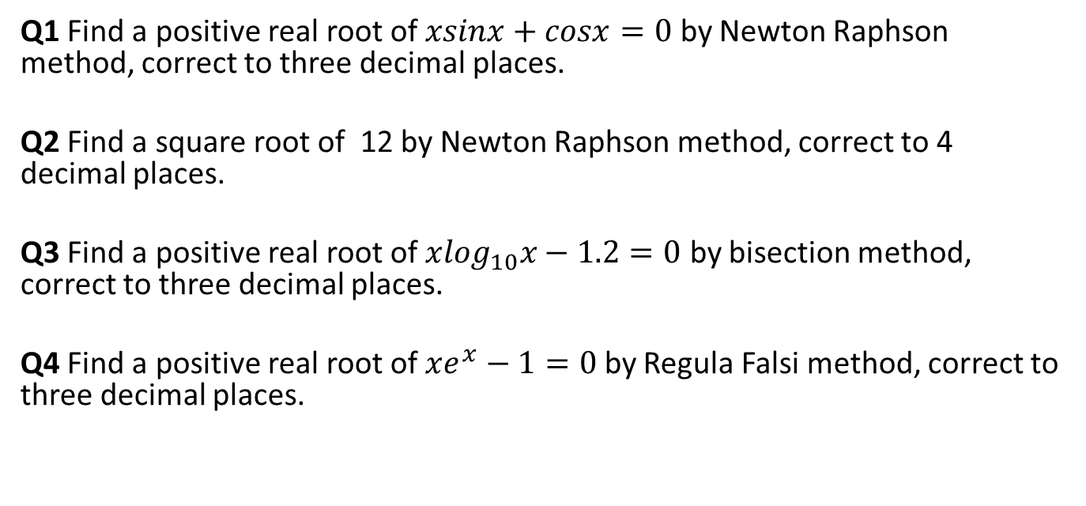
Daily Quiz[CO4]
Q1 Find a positive real root of $xsinx+cosx=0$ by Newton Raphson method, correct to three decimal places.
Q2 Find a square root of 12 by Newton Raphson method, correct to 4 decimal places.
Q3 Find a positive real root of $x\log_{10}x−1.2=0$ by bisection method, correct to three decimal places.
Q4 Find a positive real root of $xe^{x}−1=0$by RegulaFalsi method, correct to three decimal places.

Slide 31
Recap[CO4]
In the last topic, we studied iterative method for finding root of an equation
Bisection method
Regula-falsi method/method of false position
Newton Raphson method

Slide 32
Topic Objective[CO4]
In this topic, we are going to discuss the method to find the missing values of some functional values in between the given intervals, using some interpolation formulae.

Slide 33
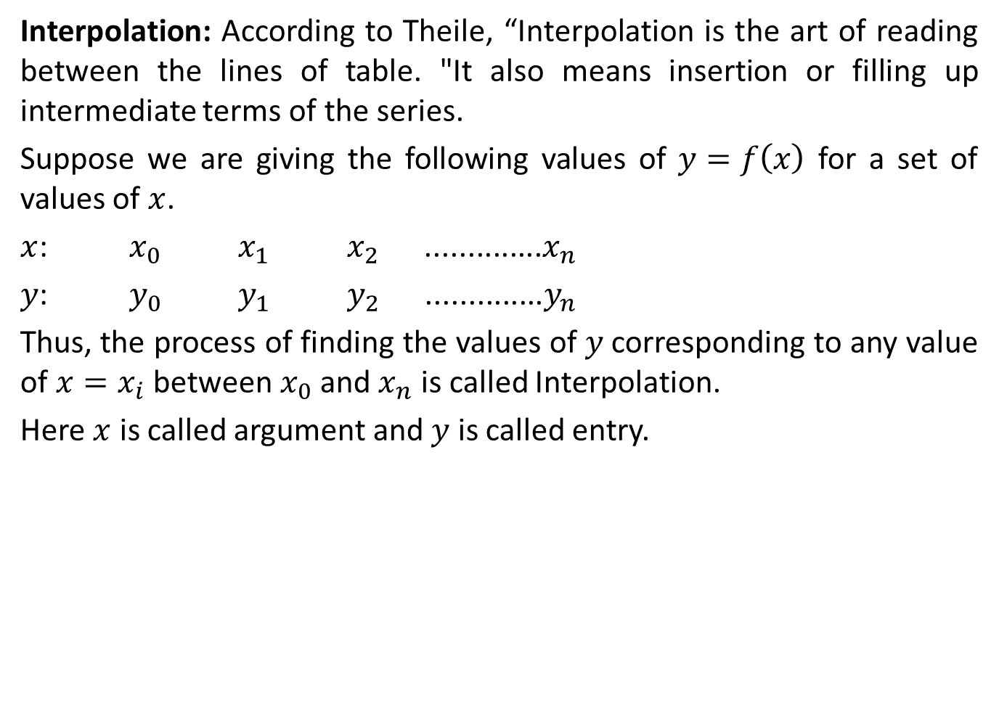
Interpolation[CO4]
Interpolation: According to Theile, “Interpolation is the art of reading between the lines of table. "It also means insertion or filling up intermediate terms of the series.
Suppose we are giving the following values of $y=f\left(x\right)$ for a set of values of $x$.
$x$: $x_{0}$$x_{1}$$x_{2}$..............$x_{n}$
$y$: $y_{0}$$y_{1}$$y_{2}$ ..............$y_{n}$
Thus, the process of finding the values of $y$corresponding to any value of $x=x_{i}$ between $x_{0}$ and $x_{n}$ is called Interpolation.
Here $x$ is called argument and $y$ is called entry.

Slide 34
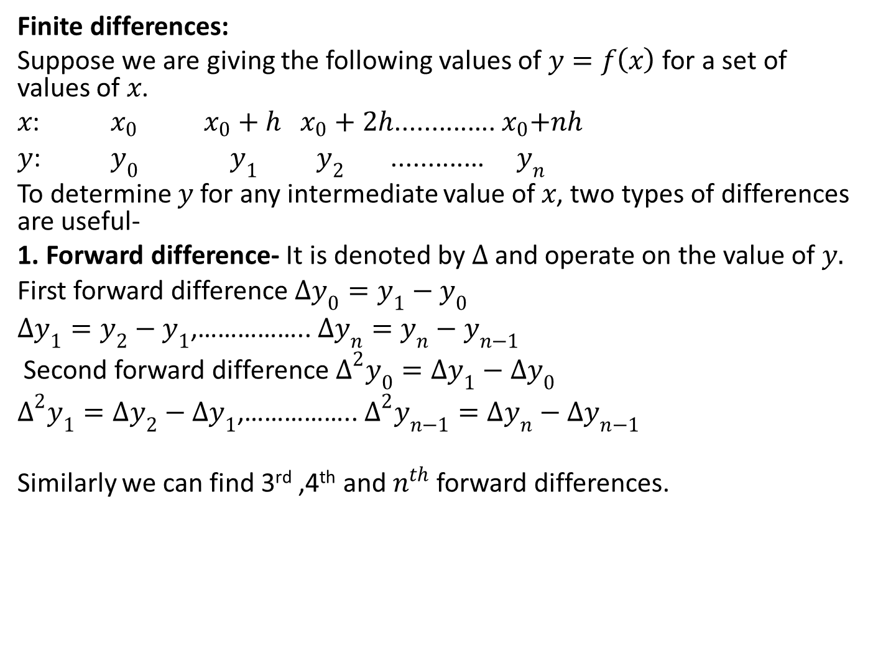
Finite differences[CO4]
Finite differences:
Suppose we are giving the following values of $y=f\left(x\right)$ for a set of values of $x$.
$x$: $x_{0}$$x_{0}+h{ x}_{0}+2h$..............${ x}_{0}+nh$
$y$: $y_{0}$$y_{1}$$y_{2}$ .............$y_{n}$
To determine $y$ for any intermediate value of $x$, two types of differences are useful-
1. Forward difference- It is denoted by $∆$ and operate on the value of $y.$
First forward difference $∆y_{0}=y_{1}−y_{0}$
$∆y_{1}=y_{2}−y_{1}$,…………….. $∆y_{n}=y_{n}−y_{n−1}$
Second forward difference $∆^{2}y_{0}={∆y}_{1}−{∆y}_{0}$
$∆^{2}y_{1}={∆y}_{2}−{∆y}_{1}$,…………….. $∆^{2}y_{n−1}={∆y}_{n}−{∆y}_{n−1}$
Similarly we can find 3rd ,4th and $n^{th}$ forward differences.

Slide 35
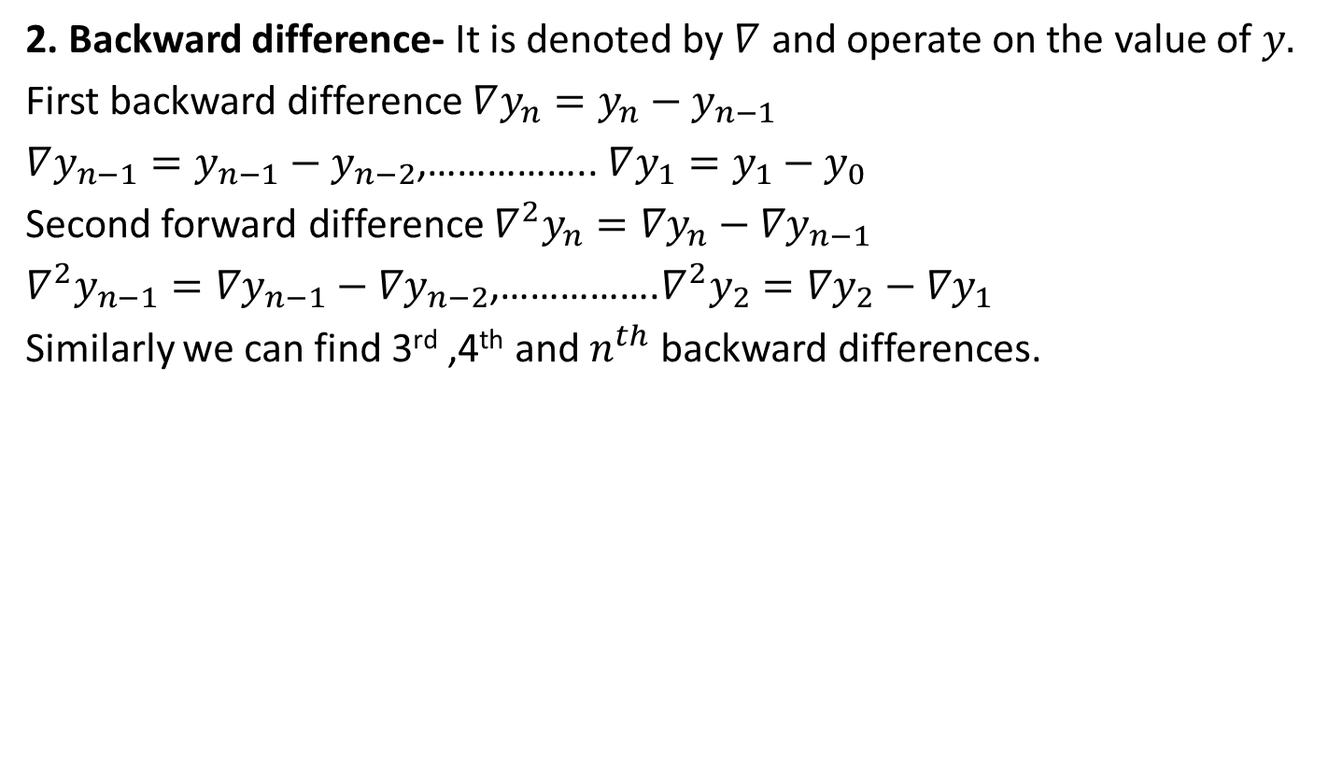
Finite differences[CO4]
2. Backward difference- It is denoted by $∇$ and operate on the value of $y.$
First backward difference $∇y_{n}=y_{n}−y_{n−1}$
$∇y_{n−1}=y_{n−1}−y_{n−2}$,…………….. $∇y_{1}=y_{1}−y_{0}$
Second forward difference $∇^{2}y_{n}={∇y}_{n}−{∇y}_{n−1}$
$∇^{2}y_{n−1}={∇y}_{n−1}−{∇y}_{n−2}$,…………….$∇^{2}y_{2}={∇y}_{2}−{∇y}_{1}$
Similarly we can find 3rd ,4th and $n^{th}$ backward differences.

Slide 36
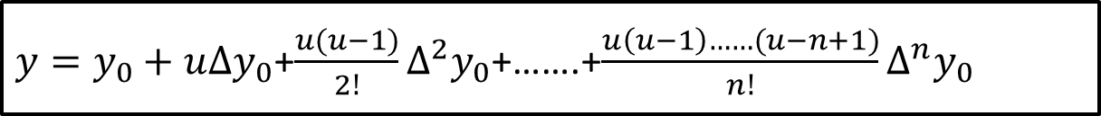
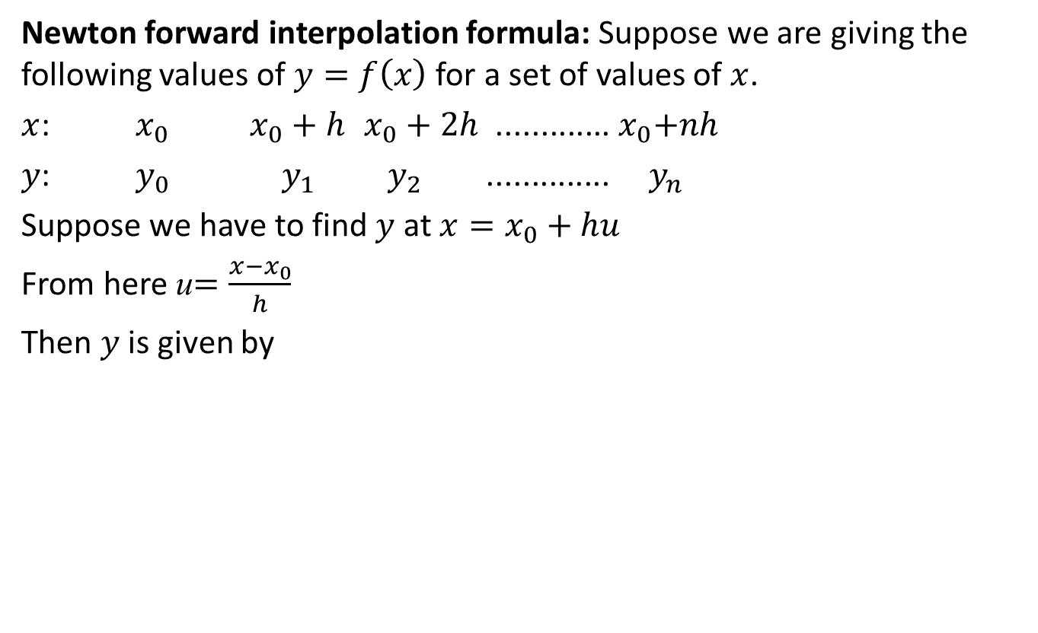
Newton forward interpolation formula[CO4]
Newton forward interpolation formula: Suppose we are giving the following values of $y=f\left(x\right)$ for a set of values of $x$.
$x$: $x_{0}$$x_{0}+h$$x_{0}+2h$.............${ x}_{0}+nh$
$y$: $y_{0}$$y_{1}$$y_{2}$ ..............$y_{n}$
Suppose we have to find $y$ at $x=x_{0}+hu$
From here u$=\frac{x−x_{0}}{h}$
Then $y$ is given by
$y=y_{0}+u∆y_{0}$+$\frac{u(u−1)}{2!}∆^{2}y_{0}$+…….+$\frac{u\left(u−1\right)……(u−n+1)}{n!}∆^{n}y_{0}$

Slide 37
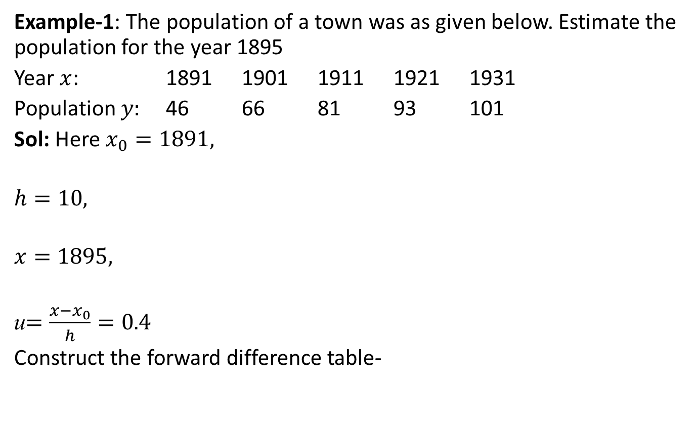
Newton forward interpolation formula[CO4]
Example-1: The population of a town was as given below. Estimate the population for the year 1895
Year $x$: 1891 1901 1911 1921 1931
Population $y:$ 46 66 81 93 101
Sol: Here $x_{0}=1891,$
$$h=10,$$
$$x=1895,$$
u$=\frac{x−x_{0}}{h}=0.4$
Construct the forward difference table-

Slide 38
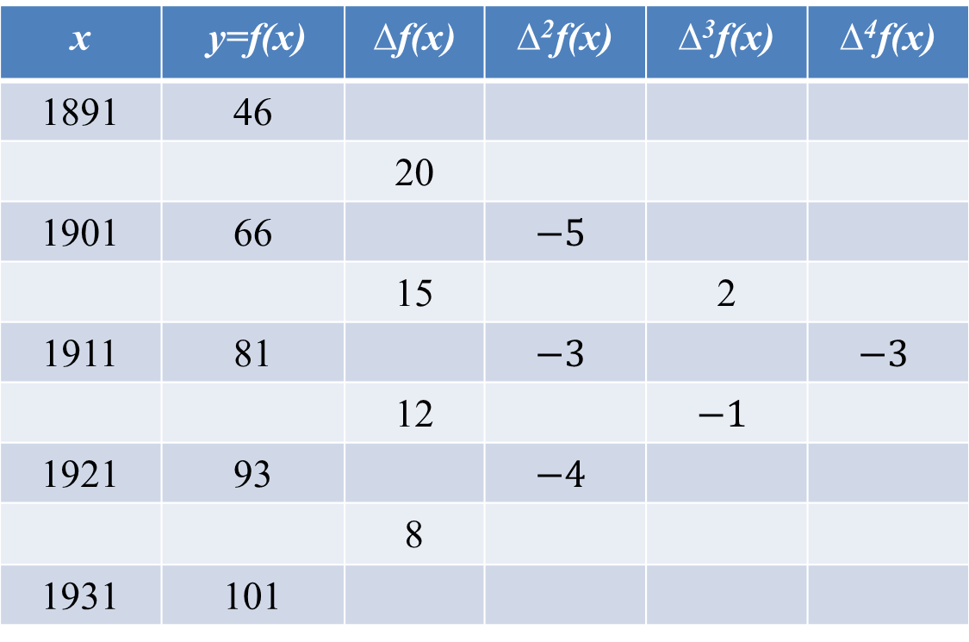
Newton forward interpolation formula[CO4]
(Forward Difference Table)
x | y=f(x) | ∆f(x) | ∆²f(x) | ∆³f(x) | ∆⁴f(x)
1891 | 46
 |  | 20
1901 | 66 |  | $$−5$$
 |  | 15 |  | 2
1911 | 81 |  | $$−3$$ |  | $$−3$$
 |  | 12 |  | $$−1$$
1921 | 93 |  | $$−4$$
 |  | 8
1931 | 101

Slide 39
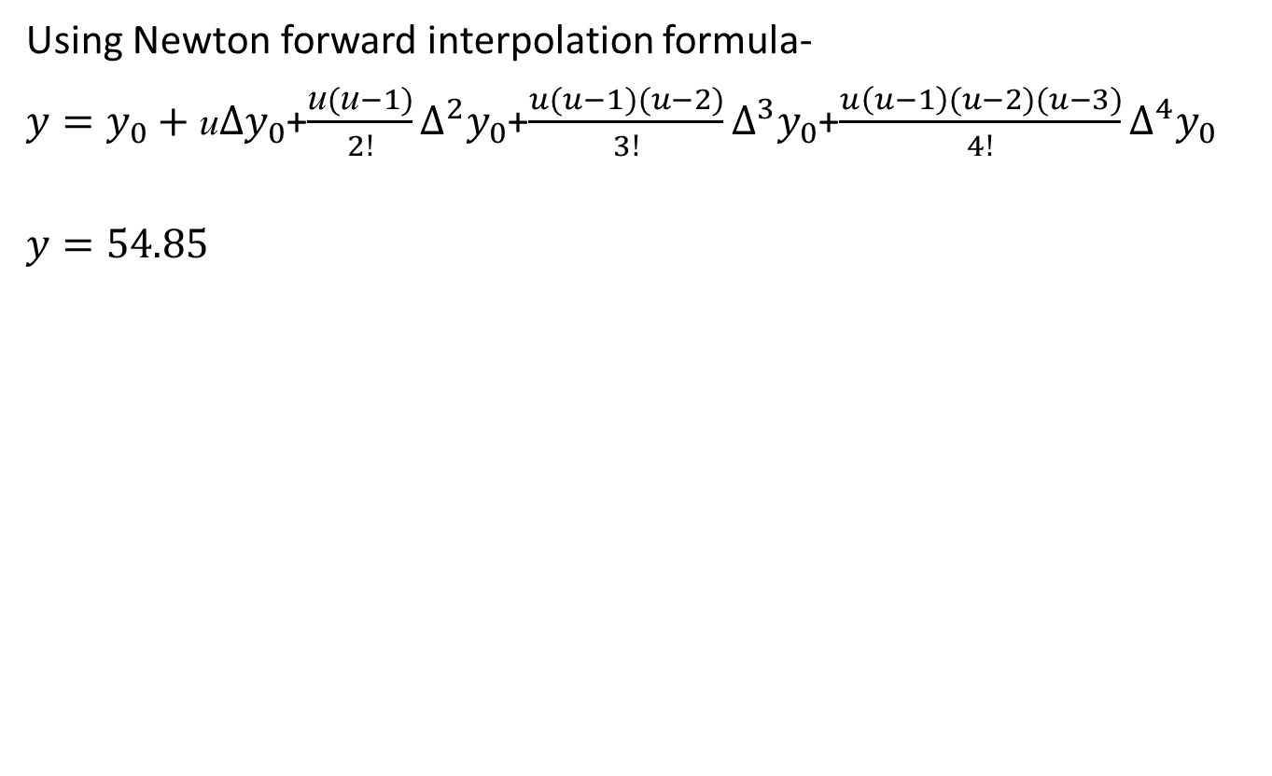
Newton forward interpolation formula[CO4]
Using Newton forward interpolation formula-
${y=y}_{0}+\text{u}∆y_{0}$+$\frac{\text{u}(\text{u}−1)}{2!}∆^{2}y_{0}$+$\frac{u(u−1)(u−2)}{3!}∆^{3}y_{0}$+$\frac{u\left(u−1\right)(u−2)(u−3)}{4!}∆^{4}y_{0}$
$$y=54.85$$

Slide 40
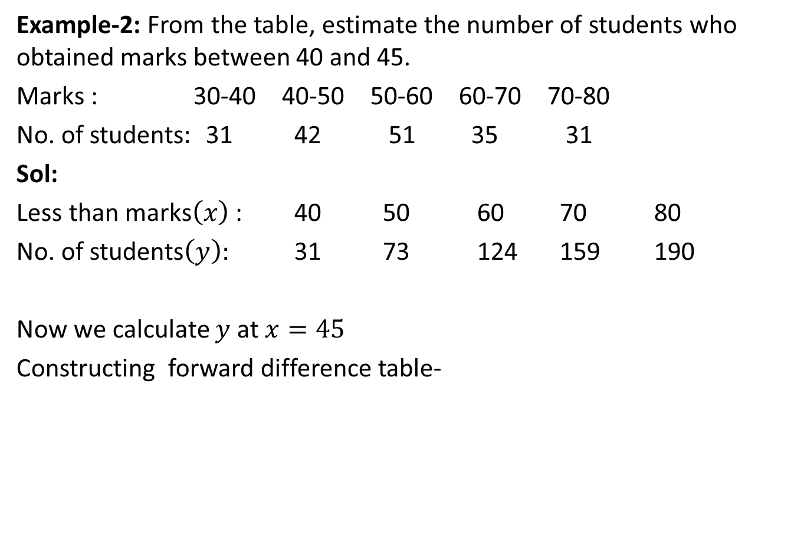
Newton forward interpolation formula[CO4]
Example-2: From the table, estimate the number of students who obtained marks between 40 and 45.
Marks : 30-40 40-50 50-60 60-70 70-80
No. of students$:$ 31 42 51 35 31
Sol:
Less than marks$\left(x\right)$ : 40 50 60 70 80
No. of students$\left(y\right):$ 31 73 124 159 190
Now we calculate $y$ at $x=45$
Constructing forward difference table-

Slide 41
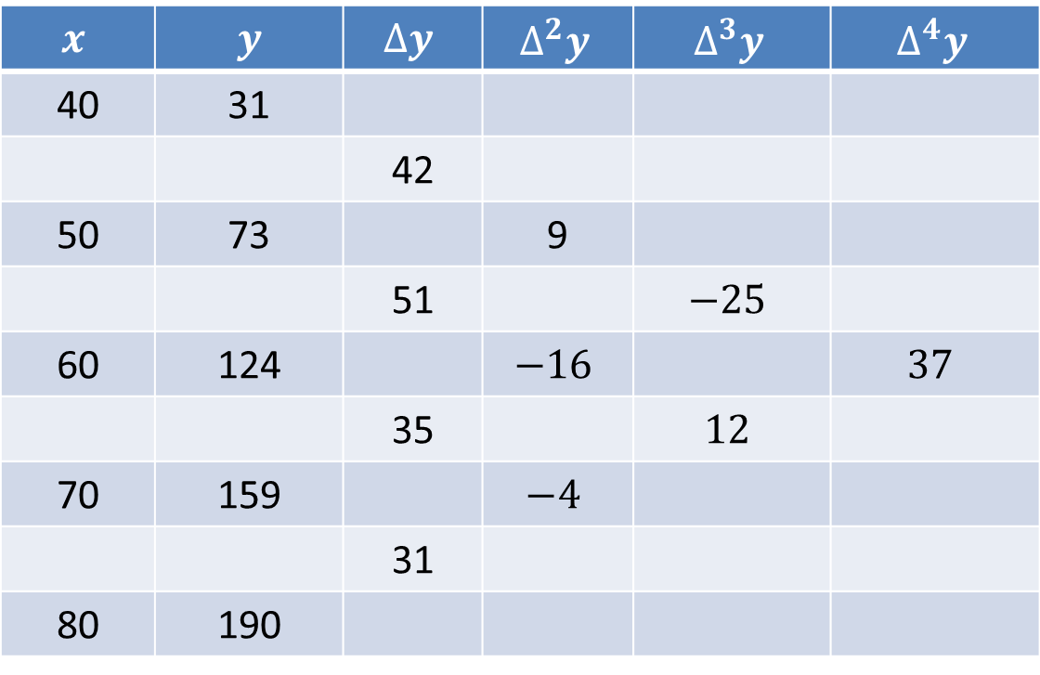
Newton forward interpolation formula[CO4]
(Forward Difference Table)
$$x$$ | $y$ | $$∆y$$ | $$∆^{2}y$$ | $$∆^{3}y$$ | $$∆^{4}y$$
40 | 31
 |  | 42
50 | 73 |  | 9
 |  | 51 |  | $$−25$$
60 | 124 |  | $$−16$$ |  | $$37$$
 |  | 35 |  | $$12$$
70 | 159 |  | $$−4$$
 |  | 31
80 | 190

Slide 42
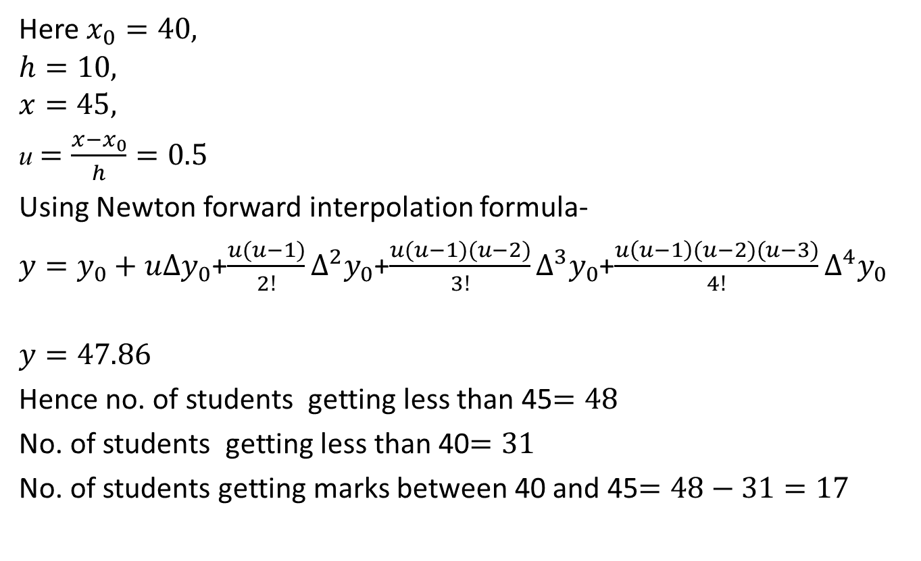
Newton forward interpolation formula[CO4]
Here $x_{0}=40,$
$$h=10,$$
$$x=45,$$
u $=\frac{x−x_{0}}{h}=0.5$
Using Newton forward interpolation formula-
${y=y}_{0}+u∆y_{0}$+$\frac{u(u−1)}{2!}∆^{2}y_{0}$+$\frac{u(u−1)(u−2)}{3!}∆^{3}y_{0}$+$\frac{u\left(u−1\right)(u−2)(u−3)}{4!}∆^{4}y_{0}$
$$y=47.86$$
Hence no. of students getting less than 45$=48$
No. of students getting less than 40$=31$
No. of students getting marks between 40 and 45$=48−31=17$

Slide 43
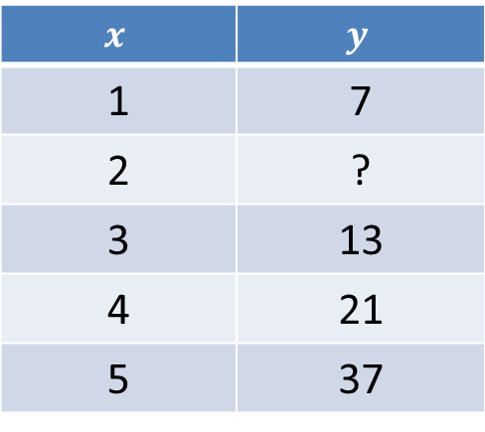
Newton forward interpolation formula[CO4]
Example-3 find the missing term in the following table-
Sol: Constructing forward difference table-
$$x$$ | $$y$$
1 | 7
2 | ?
3 | 13
4 | 21
5 | 37

Slide 44
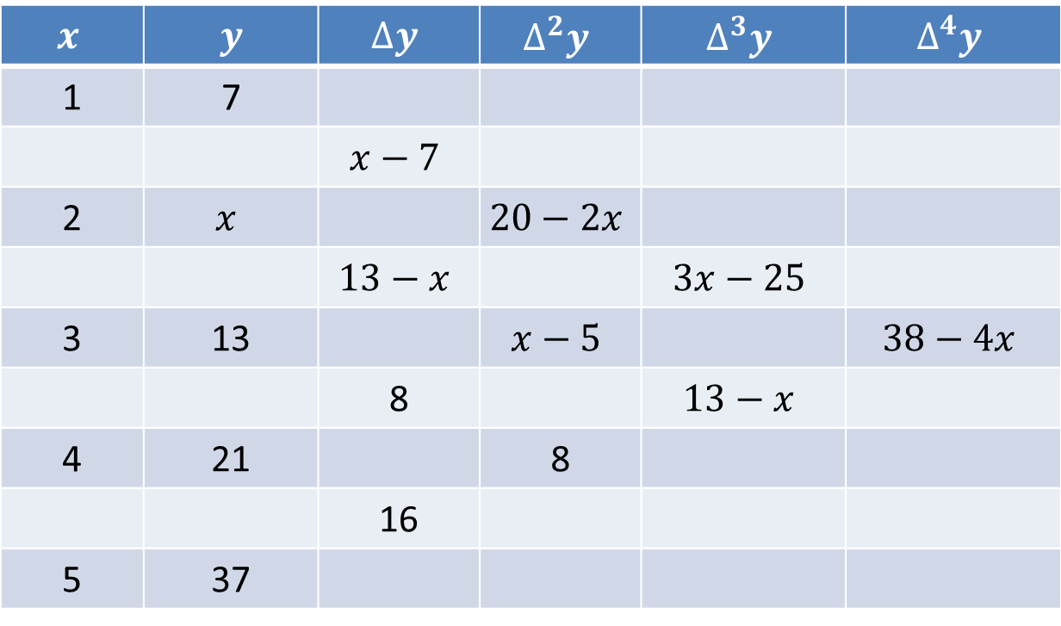
Newton forward interpolation formula[CO4]
(Forward Difference Table)
$$x$$ | $y$ | $$∆y$$ | $$∆^{2}y$$ | $$∆^{3}y$$ | $$∆^{4}y$$
1 | 7
 |  | $$x−7$$
2 | $$x$$ |  | $$20−2x$$
 |  | $$13−x$$ |  | $$3x−25$$
3 | 13 |  | $$x−5$$ |  | $$38−4x$$
 |  | 8 |  | $$13−x$$
4 | 21 |  | 8
 |  | 16
5 | 37

Slide 45
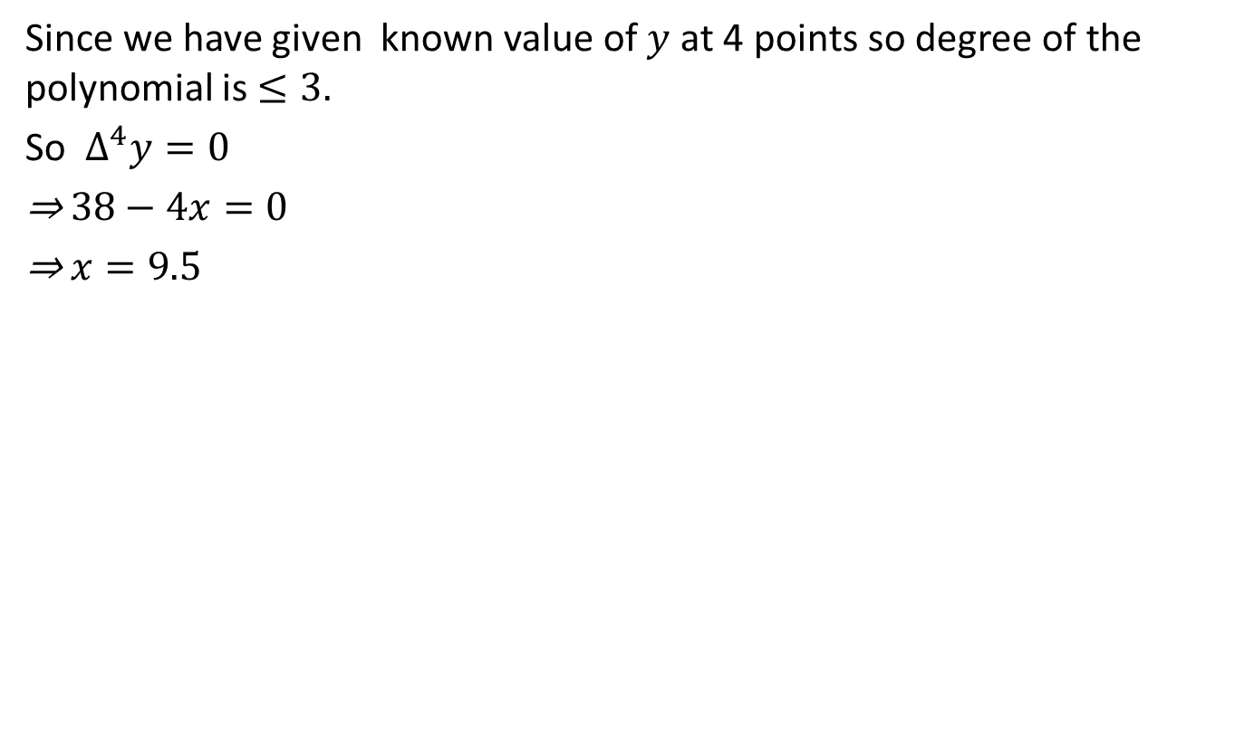
Newton forward interpolation formula[CO4]
Sincewe have given known value of $y$ at 4 points so degree of the polynomial is $≤3.$
So $∆^{4}y=0$
⇒ $38−4x=0$
⇒ $x=9.5$

Slide 46
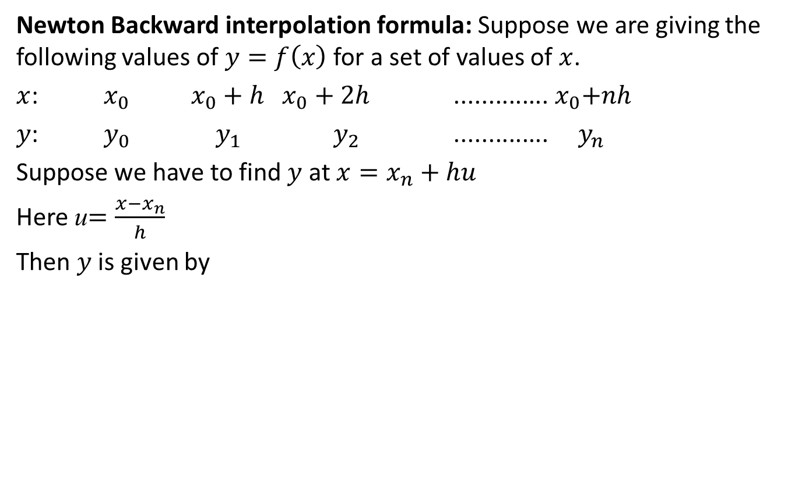
Newton Backward interpolation formula[CO4]
Newton Backward interpolation formula: Suppose we are giving the following values of $y=f\left(x\right)$ for a set of values of $x$.
$x$: $x_{0}$$x_{0}+h{ x}_{0}+2h$ ..............${ x}_{0}+nh$
$y$: $y_{0}$$y_{1}$$y_{2}$ ..............$y_{n}$
Suppose we have to find $y$ at $x=x_{n}+hu$
Here u$=\frac{x−x_{n}}{h}$
Then $y$ is given by
f(x_{n}+hu)$=y_{n}+u∇y_{n}$+$\frac{u(u+1)}{2!}∇^{2}y_{n}$+…….+$\frac{u\left(u+1\right)……(u+n−1)}{n!}∇^{2}y_{n}$

Slide 47
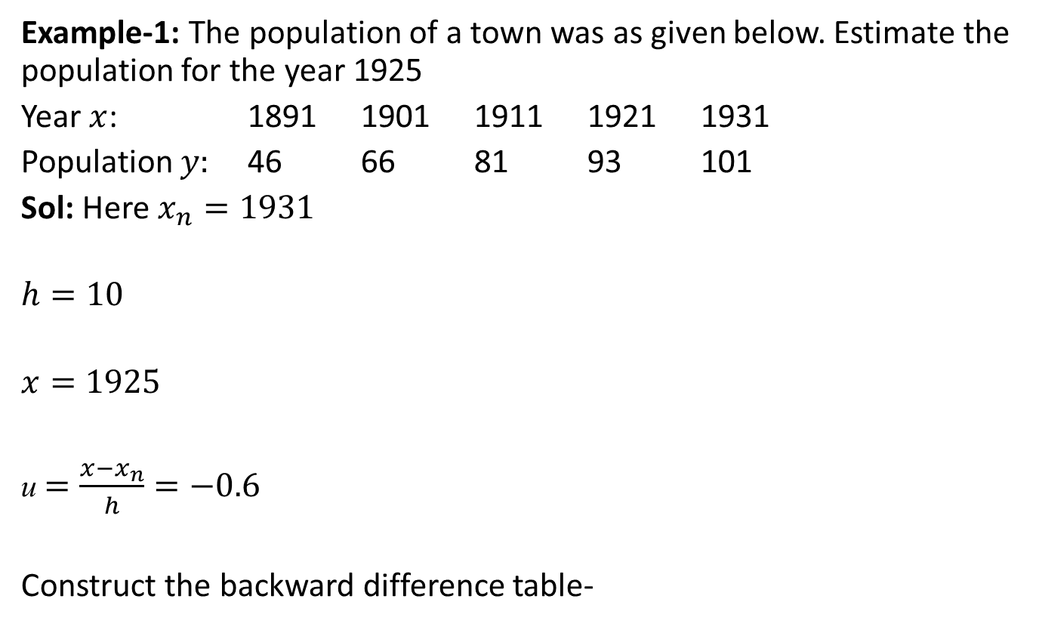
Newton Backward interpolation formula[CO4]
Example-1: The population of a town was as given below. Estimate the population for the year 1925
Year $x$: 1891 1901 1911 1921 1931
Population $y:$ 46 66 81 93 101
Sol: Here $x_{n}=1931$
$$h=10$$
$$x=1925$$
u $=\frac{x−x_{n}}{h}=−0.6$
Construct the backward difference table-

Slide 48
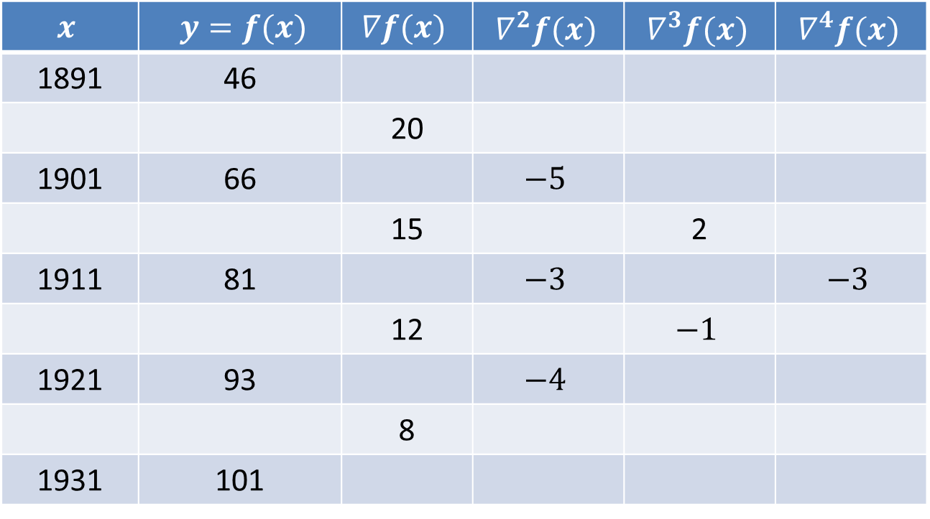
Newton Backward interpolation formula[CO4]
(Backward Difference Table)
$$x$$ | $y=f(x)$ | $$∇f(x)$$ | $$∇^{2}f(x)$$ | $$∇^{3}f(x)$$ | $$∇^{4}f(x)$$
1891 | 46
 |  | 20
1901 | 66 |  | $$−5$$
 |  | 15 |  | 2
1911 | 81 |  | $$−3$$ |  | $$−3$$
 |  | 12 |  | $$−1$$
1921 | 93 |  | $$−4$$
 |  | 8
1931 | 101

Slide 49
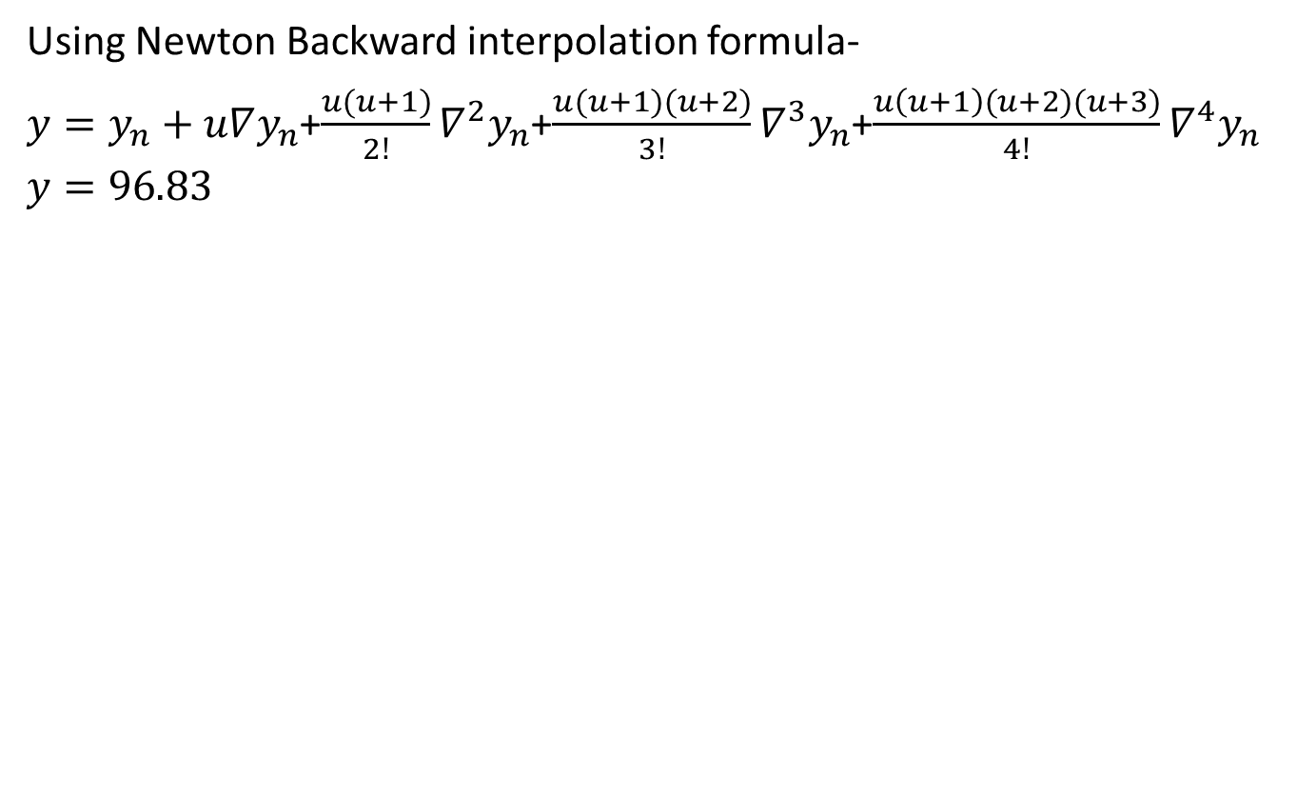
Newton Backward interpolation formula[CO4]
Using Newton Backward interpolation formula-
${y=y}_{n}+u∇y_{n}$+$\frac{u(u+1)}{2!}∇^{2}y_{n}$+$\frac{u(u+1)(u+2)}{3!}∇^{3}y_{n}$+$\frac{u\left(u+1\right)(u+2)(u+3)}{4!}∇^{4}y_{n}$
$$y=96.83$$

Slide 50

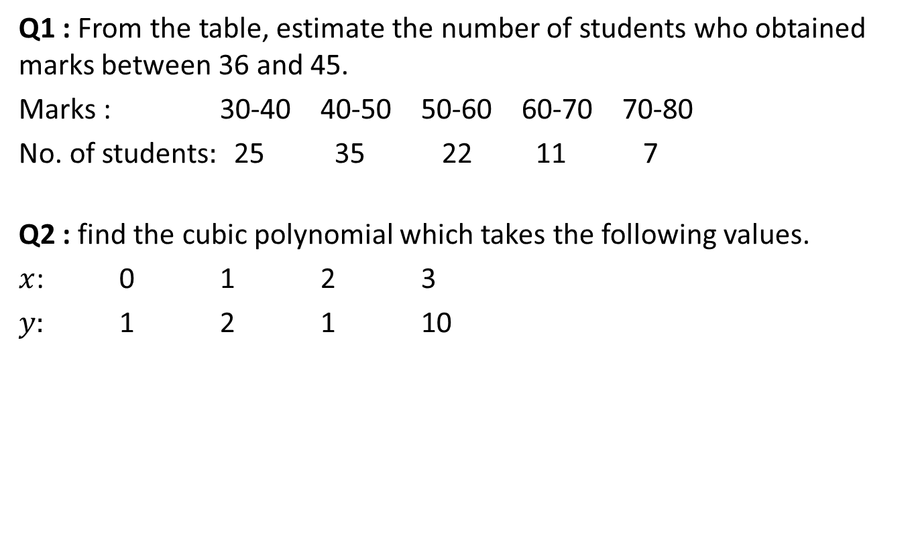
Daily Quiz[CO4]
Q1 : From the table, estimate the number of students who obtained marks between 36 and 45.
Marks : 30-40 40-50 50-60 60-70 70-80
No. of students$:$ 25 35 22 11 7
Q2 : find the cubic polynomial which takes the following values.
$x$: 0 1 2 3
$y:$ 1 2 1 10

Slide 51
Recap[CO4]
Interpolation for equal intervals:
Newton forward interpolation formula
Newton backward interpolation formula

Slide 52
Topic Objective[CO4]
In this topic, we will discuss the interpolation formulae for unequal intervals.

Slide 53
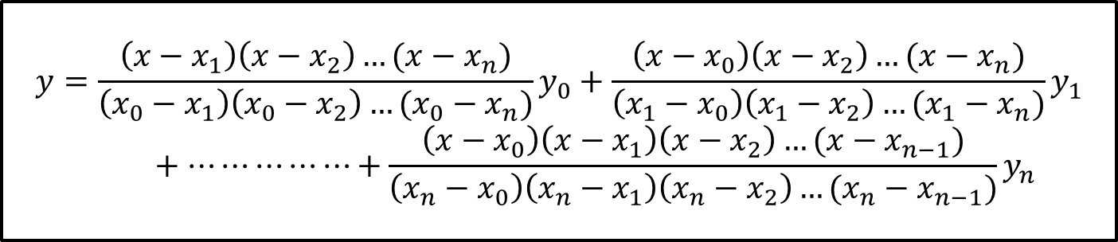
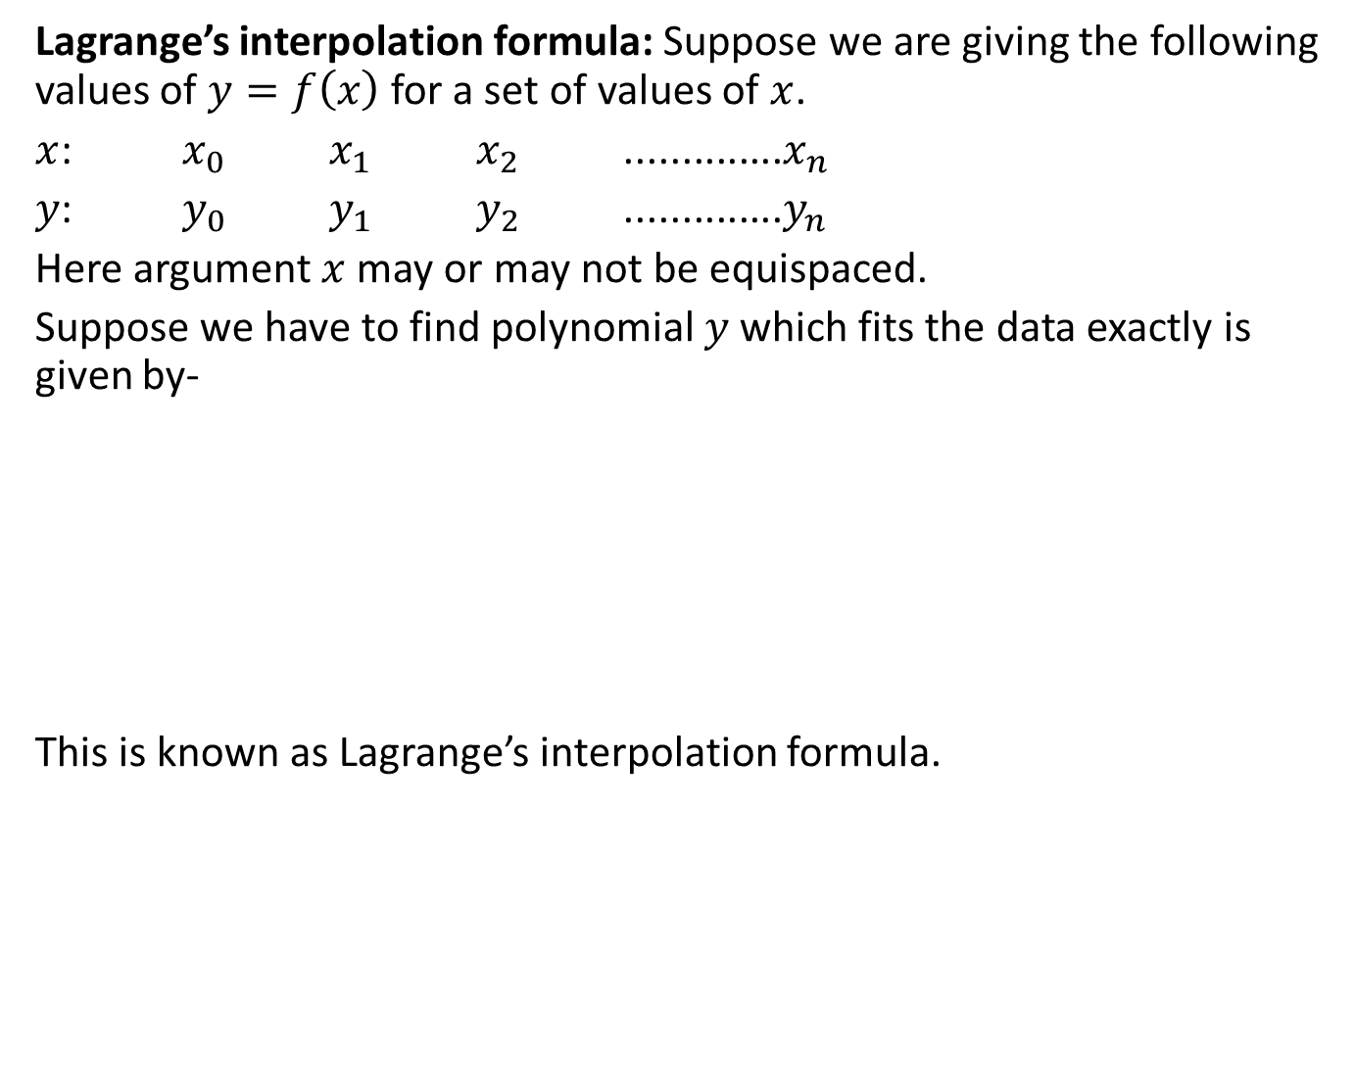
Lagrange’s interpolation formula[CO4]
Lagrange’s interpolation formula: Suppose we are giving the following values of $y=f\left(x\right)$ for a set of values of $x$.
$x$: $x_{0}$$x_{1}$$x_{2}$ ..............$x_{n}$
$y$: $y_{0}$$y_{1}$$y_{2}$ ..............$y_{n}$
Here argument $x$ may or may not be equispaced.
Suppose we have to find polynomial $y$ which fits the data exactly is given by-
This is known as Lagrange’s interpolation formula.
$$y=\frac{\left(x−x_{1}\right)\left(x−x_{2}\right)…(x−x_{n})}{\left(x_{0}−x_{1}\right)\left(x_{0}−x_{2}\right)…(x_{0}−x_{n})}y_{0}+\frac{\left(x−x_{0}\right)\left(x−x_{2}\right)…(x−x_{n})}{\left(x_{1}−x_{0}\right)\left(x_{1}−x_{2}\right)…(x_{1}−x_{n})}y_{1}+…⋯⋯⋯⋯+\frac{\left(x−x_{0}\right)\left(x−x_{1}\right)\left(x−x_{2}\right)…(x−x_{n−1})}{\left(x_{n}−x_{0}\right)\left(x_{n}−x_{1}\right)\left(x_{n}−x_{2}\right)…(x_{n}−x_{n−1})}y_{n}$$

Slide 54
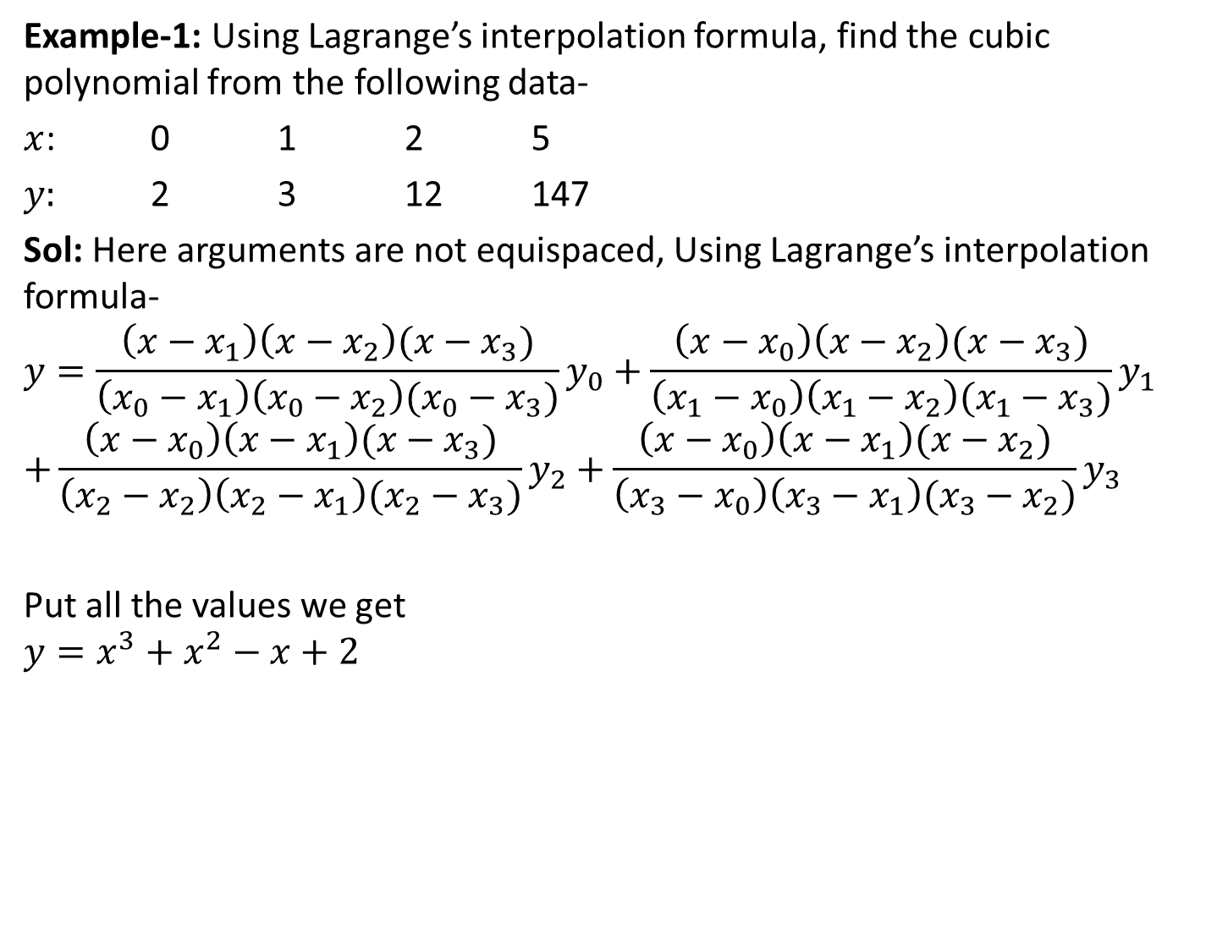
Lagrange’s interpolation formula[CO4]
Example-1: Using Lagrange’s interpolation formula, find the cubic polynomial from the following data-
$x$: 0 1 2 5
$y:$ 2 3 12 147
Sol: Here arguments are not equispaced, Using Lagrange’s interpolation formula-
$$y=\frac{\left(x−x_{1}\right)\left(x−x_{2}\right)(x−x_{3})}{\left(x_{0}−x_{1}\right)\left(x_{0}−x_{2}\right)(x_{0}−x_{3})}y_{0}+\frac{\left(x−x_{0}\right)\left(x−x_{2}\right)(x−x_{3})}{\left(x_{1}−x_{0}\right)\left(x_{1}−x_{2}\right)(x_{1}−x_{3})}y_{1}$$
$$+\frac{\left(x−x_{0}\right)\left(x−x_{1}\right)(x−x_{3})}{\left(x_{2}−x_{2}\right)\left(x_{2}−x_{1}\right)(x_{2}−x_{3})}y_{2}+\frac{\left(x−x_{0}\right)\left(x−x_{1}\right)(x−x_{2})}{\left(x_{3}−x_{0}\right)\left(x_{3}−x_{1}\right)(x_{3}−x_{2})}y_{3}$$
Put all the values we get
$$y=x^{3}+x^{2}−x+2$$

Slide 55
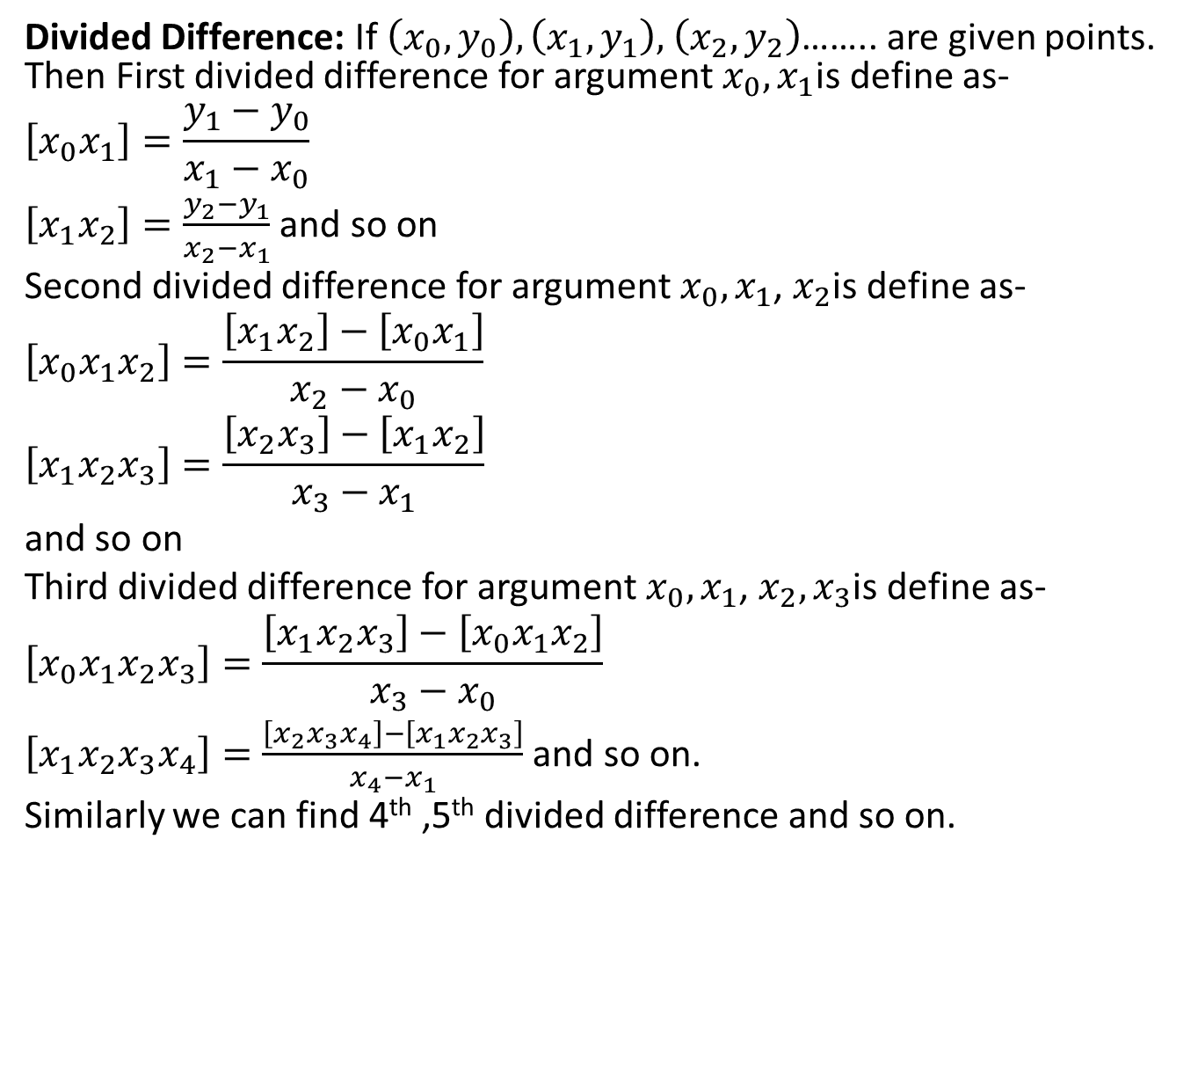
Divided Difference[CO4]
Divided Difference: If $\left(x_{0},y_{0}\right),\left(x_{1},y_{1}\right),$$\left(x_{2},y_{2}\right)$…….. are given points. Then First divided difference for argument $x_{0}{,x}_{1}$is define as-
$$\left[x_{0}x_{1}\right]=\frac{y_{1}−y_{0}}{x_{1}−x_{0}}$$
$\left[x_{1}x_{2}\right]=\frac{y_{2}−y_{1}}{x_{2}−x_{1}}$ and so on
Second divided difference for argument $x_{0}{,x}_{1}$, $x_{2}$is define as-
$$\left[x_{0}x_{1}x_{2}\right]=\frac{\left[x_{1}x_{2}\right]−\left[x_{0}x_{1}\right]}{x_{2}−x_{0}}$$
$$\left[x_{1}x_{2}x_{3}\right]=\frac{\left[x_{2}x_{3}\right]−\left[x_{1}x_{2}\right]}{x_{3}−x_{1}}$$
and so on
Third divided difference for argument $x_{0}{,x}_{1}$, $x_{2},x_{3}$is define as-
$$\left[x_{0}x_{1}x_{2}x_{3}\right]=\frac{\left[x_{1}x_{2}x_{3}\right]−\left[x_{0}x_{1}x_{2}\right]}{x_{3}−x_{0}}$$
$\left[x_{1}x_{2}x_{3}x_{4}\right]=\frac{\left[x_{2}x_{3}x_{4}\right]−\left[x_{1}x_{2}x_{3}\right]}{x_{4}−x_{1}}$ and so on.
Similarly we can find 4th ,5th divided difference and so on.

Slide 56
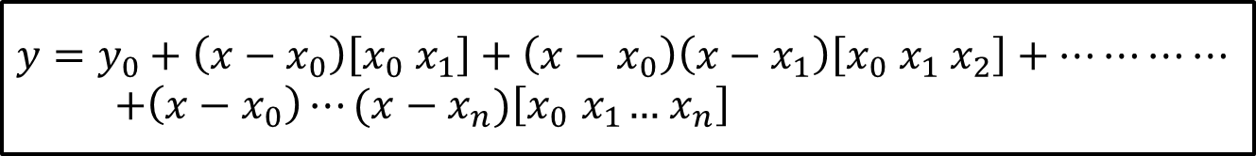
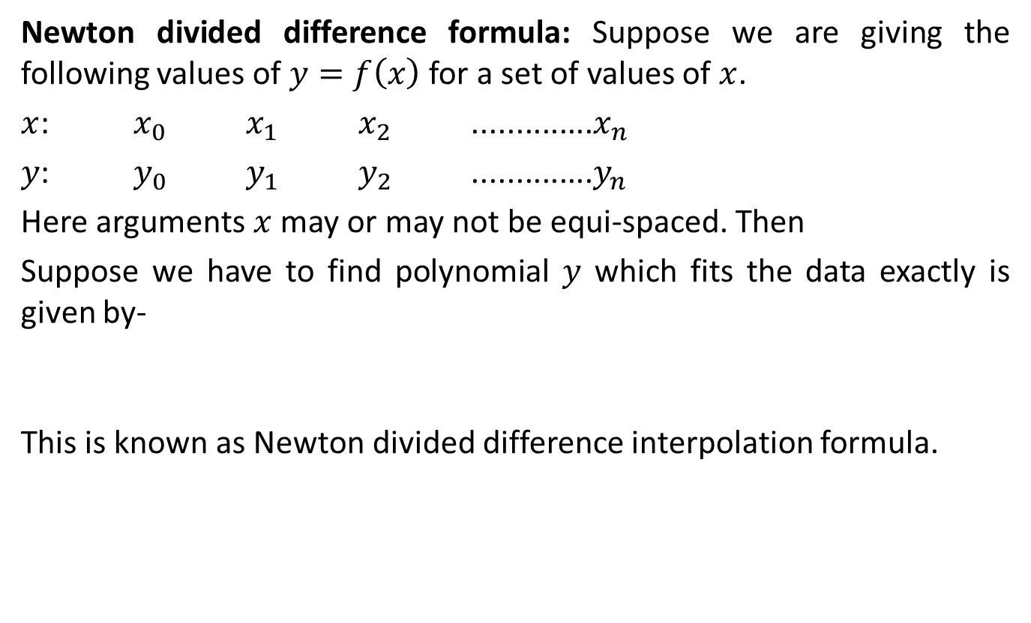
Newton divided difference formula[CO4]
Newton divided difference formula: Suppose we are giving the following values of $y=f\left(x\right)$ for a set of values of $x$.
$x$: $x_{0}$$x_{1}$$x_{2}$ ..............$x_{n}$
$y$: $y_{0}$$y_{1}$$y_{2}$ ..............$y_{n}$
Here arguments $x$ may or may not be equi-spaced. Then
Suppose we have to find polynomial $y$ which fits the data exactly is given by-
This is known as Newton divided difference interpolation formula.
$$y=y_{0}+\left(x−x_{0}\right)\left[x_{0}{ x}_{1}\right]+\left(x−x_{0}\right)\left(x−x_{1}\right)\left[x_{0}{ x}_{1} x_{2}\right]+⋯⋯⋯⋯$$
$+\left(x−x_{0}\right)⋯(x−x_{n})\left[x_{0}{ x}_{1}…{ x}_{n}\right]$

Slide 57
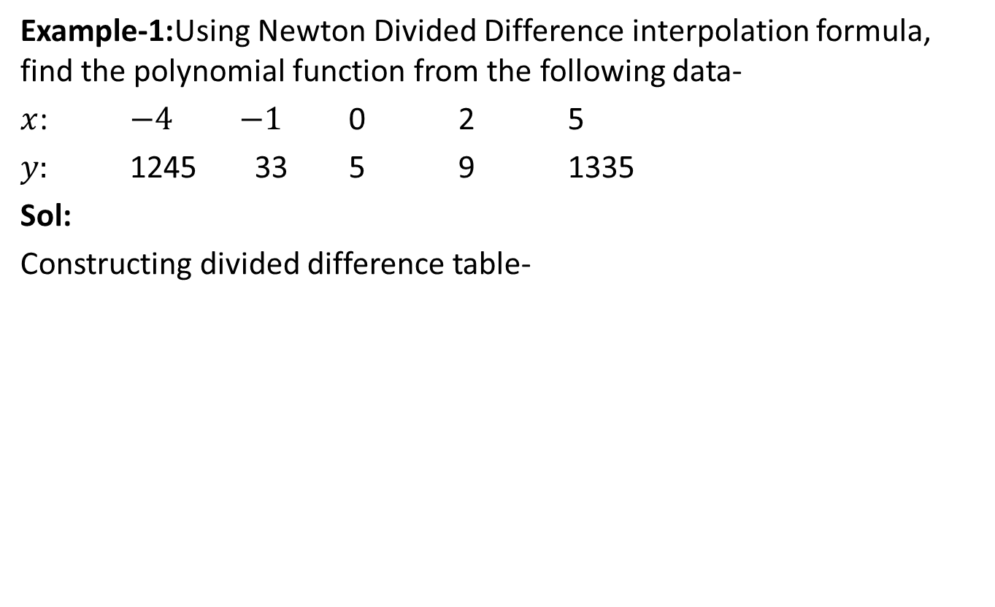
Newton divided difference formula[CO4]
Example-1:Using Newton Divided Difference interpolation formula, find the polynomial function from the following data-
$x$: $−4$$−1$ 0 2 5
$y:$ 1245 33 5 9 1335
Sol:
Constructing divided difference table-

Slide 58
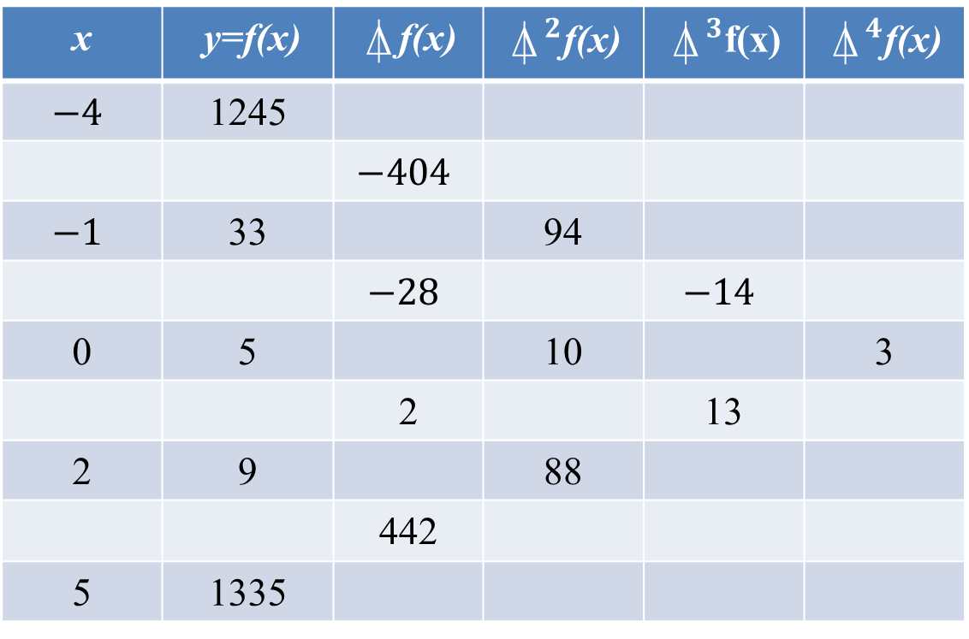
Newton divided difference formula[CO4]
(Divided Difference Table)
x | y=f(x) | $⍋$f(x) | $⍋^{2}$f(x) | $⍋^{3}$f(x) | $⍋^{4}$f(x)
$$−4$$ | 1245
 |  | $$−404$$
$$−1$$ | 33 |  | 94
 |  | $$−28$$ |  | $$−14$$
0 | 5 |  | 10 |  | 3
 |  | 2 |  | 13
2 | 9 |  | 88
 |  | 442
5 | 1335

Slide 59
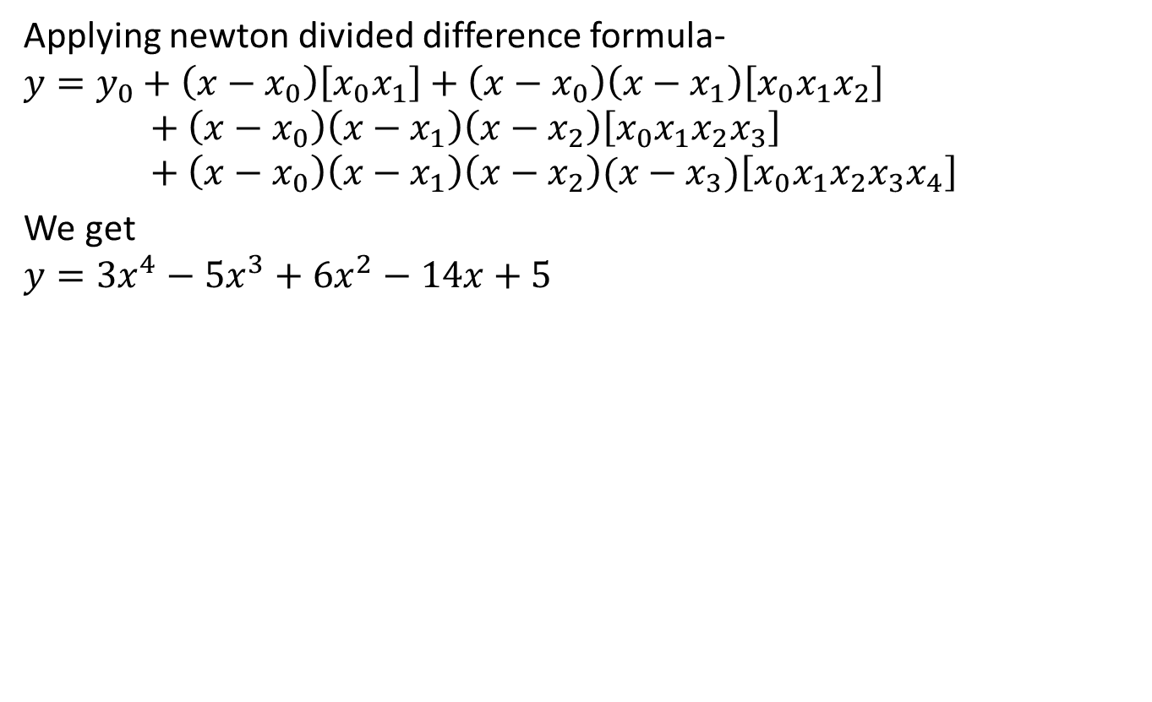
Newton divided difference formula[CO4]
Applying newton divided difference formula-
$$y=y_{0}+\left(x−x_{0}\right)\left[x_{0}x_{1}\right]+\left(x−x_{0}\right)\left(x−x_{1}\right)\left[x_{0}x_{1}x_{2}\right]+\left(x−x_{0}\right)\left(x−x_{1}\right)\left(x−x_{2}\right)\left[x_{0}x_{1}x_{2}x_{3}\right]+\left(x−x_{0}\right)\left(x−x_{1}\right)\left(x−x_{2}\right)(x−x_{3})\left[x_{0}x_{1}x_{2}x_{3}x_{4}\right]$$
We get
$$y={3x}^{4}−5x^{3}+6x^{2}−14x+5$$

Slide 60
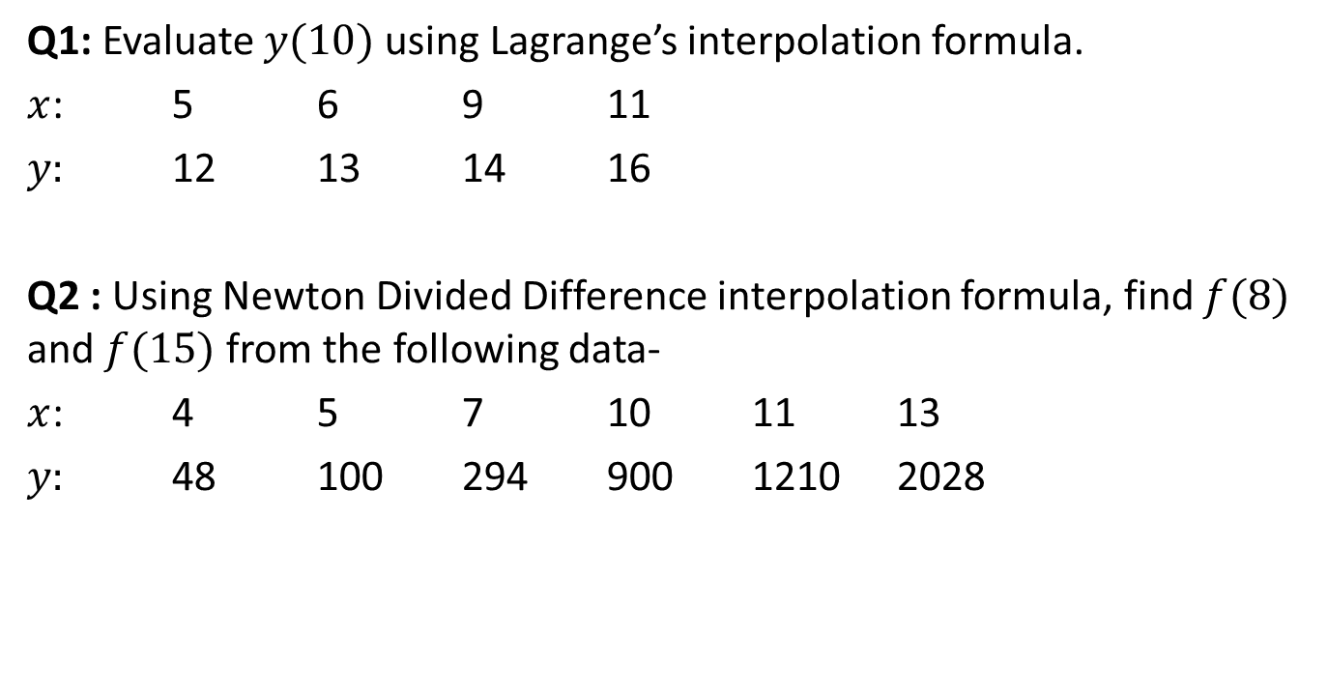
Daily quiz[CO4]
Q1: Evaluate $y(10)$ using Lagrange’s interpolation formula.
$x$: 5 6 9 11
$y:$ 12 13 14 16
Q2 : Using Newton Divided Difference interpolation formula, find $f(8)$ and $f(15)$ from the following data-
$x$: 4 5 7 10 11 13
$y:$ 48 100 294 900 1210 2028

Slide 61
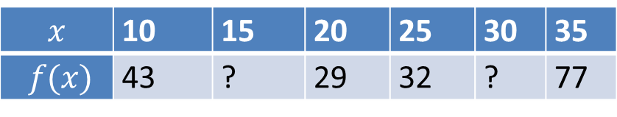
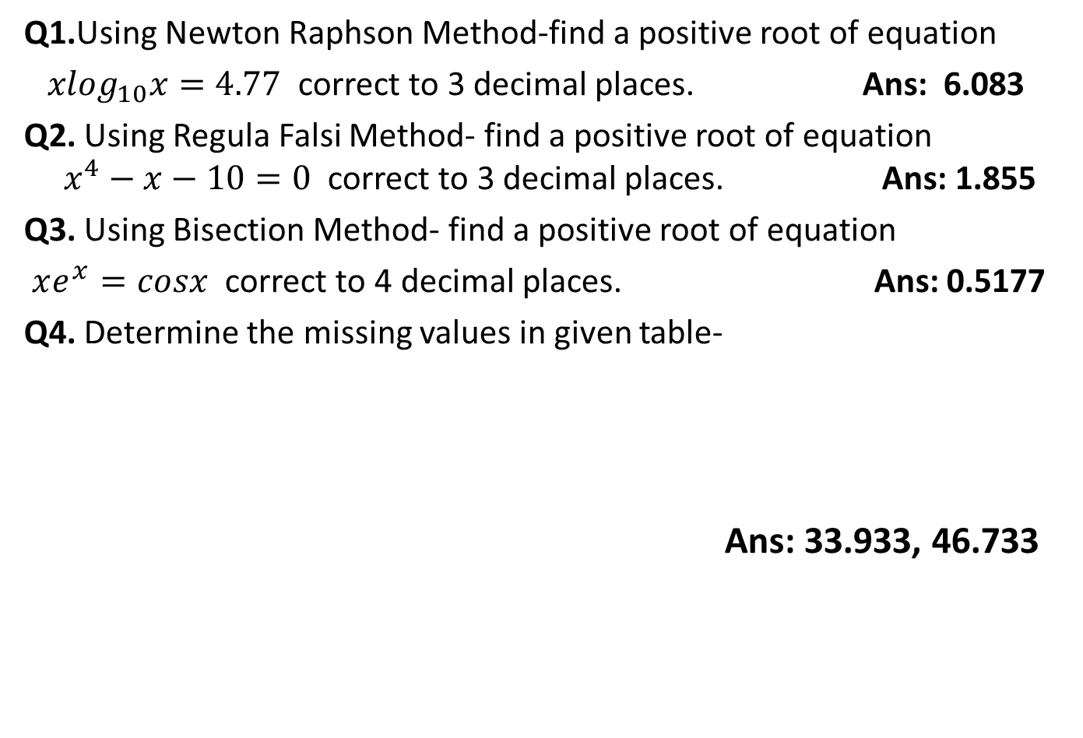
Weekly Assignment(CO4)
Q1.Using Newton Raphson Method-find a positive root of equation
${xlog}_{10}x=4.77$ correct to 3 decimal places. Ans: 6.083
Q2. Using RegulaFalsi Method- find a positive root of equation $x^{4}−x−10=0$ correct to 3 decimal places. Ans: 1.855
Q3. Using Bisection Method- find a positive root of equation
$xe^{x}=cosx$ correct to 4 decimal places. Ans: 0.5177
Q4. Determine the missing values in given table-
Ans: 33.933, 46.733
$$x$$ | 10 | 15 | 20 | 25 | 30 | 35
$$f(x)$$ | 43 | ? | 29 | 32 | ? | 77

Slide 62
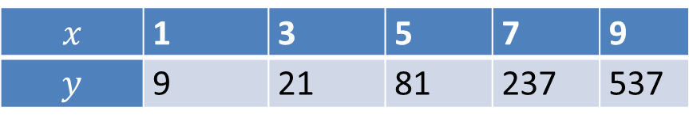

Weekly Assignment(CO4)
Q5. Find the number of students from the following data who secured marks not more than 45
Ans: 51
Q6.From the following table find the value of $y$ at $x=8$
Marks | 30-40 | 40-50 | 50-60 | 60-70 | 70-80
No. of Students | 35 | 48 | 70 | 40 | 22
$$x$$ | 1 | 3 | 5 | 7 | 9
$$y$$ | 9 | 21 | 81 | 237 | 537
Ans: 366

Slide 63



Weekly Assignment(CO4)
Q7.Obtain Lagrange’s interpolatory polynomial for the following data-
Also find the value of $y$ at $x=1.5.$
Ans: $x^{3}−9x^{2}+17x+6$, 14.625
Q8. Find the interpolating polynomial and hence compute $f(1)$ from the following table-
Ans: ${5x}^{4}+9x^{3}−27x^{2}−21x−12, −46$
$$x$$ | -1 | 1 | 2 | 3
$$y$$ | -21 | 15 | 12 | 3
$$x$$ | $$−3$$ | $$−1$$ | 0 | 3 | 5
$$f(x)$$ | $$−30$$ | $$−22$$ | $$−12$$ | 330 | 3458

Slide 64
Recap[CO4]
In the last lecture, we have discuss the following methods:
Lagrange’s interpolation formula
Newton divided interpolation formula

Slide 65
Topic objective [CO4]
Intent of this topic is to solve approximately large system of linear equations using numerical methods.

Slide 66

Solution of system of linear equations[CO4]
Consider a non-homogeneous system of three simultaneous linear algebraic equations in three unknowns as
$$a_{11}x_{1}+ a_{12}x_{2} + a_{13}x_{3} = b_{1}$$
$$a_{21}x_{1}+ a_{22}x_{2} + a_{23}x_{3} = b_{2} ……………..(1)$$
$a_{31}x_{1}+ a_{32}x_{2} + a_{33}x_{3} = b_{3}$
where all $a_{ij}$'s and $b_{j}$'s are constants.
Using matrix notation, the above system (1) can be written as
$AX=B$ .................(2)
$\left[\begin{matrix}a_{11} & a_{12} & a_{13} \\ a_{21} & a_{22} & a_{23} \\ a_{31} & a_{32} & a_{33}\end{matrix}\right]$$\left[\begin{matrix}x_{1} \\ x_{2} \\ x_{3}\end{matrix}\right]$=$\left[\begin{matrix}b_{1} \\ b_{2} \\ b_{3}\end{matrix}\right]$
By finding a solution of the system, we mean to obtain the values of three unknowns$x_{1}$, $x_{2}$ and $x_{3}$ such that they satisfy the given equations

Slide 67
Matrix Decomposition Method [CO4]
This method is also known as Triangularization method or method of factorization.
The given system of equations can be written in matrix form as AX=B.......(1)
Factor A into LU, where L is lower triangular matrix and U is upper triangular matrix.
Put A=LU in (1), we have LUX=B......(2)
Let UX=Y....(3) then (2) becomes LY=B.....(4)
Solve (4) for Y using forward substitution

Slide 68
Matrix Decomposition Method[CO4]
Putting the value of Y in (3) and solve it for X using back substitution method.
Some important points:
If we take all the diagonal elements of L=1 then the method is called Doolittle’s method.
If we take all the diagonal elements of U=1 then the method is called Crout’s method.
The method fails if any of the diagonal elements of L or U is zero.

Slide 69

Crout’s method [CO4]
Example: Solve, by Crout’s method, the following system of equations: $$x+y+z=3, 2x−y+3z=16, 3x+y−z=−3$$
Solution:
The above system of equations can be written in matrix form as AX=B...........(1)
Where $A=\left[\begin{matrix}1 & 1 & 1 \\ 2 & −1 & 3 \\ 3 & 1 & −1\end{matrix}\right]$$X=\left[\begin{matrix}x \\ y \\ z\end{matrix}\right]$ and $B=\left[\begin{matrix}3 \\ 16 \\ −3\end{matrix}\right]$
In Crout’s method $A=LU$.............(2)
$\left[\begin{matrix}1 & 1 & 1 \\ 2 & −1 & 3 \\ 3 & 1 & −1\end{matrix}\right]$=$\left[\begin{matrix}l_{11} & 0 & 0 \\ l_{21} & l_{22} & 0 \\ l_{31} & l_{32} & l_{33}\end{matrix}\right]$$\left[\begin{matrix}1 & u_{12} & u_{13} \\ 0 & 1 & u_{23} \\ 0 & 0 & 1\end{matrix}\right]$

Slide 70

Crout’s method [CO4]
On simplifying, we get
L=$\left[\begin{matrix}1 & 0 & 0 \\ 2 & −3 & 0 \\ 3 & −2 & \frac{−14}{3}\end{matrix}\right]$ U=$\left[\begin{matrix}1 & 1 & 1 \\ 0 & 1 & \frac{−1}{3} \\ 0 & 0 & 1\end{matrix}\right]$
Put A=LU in (1), we have LUX=B..........................(3)
Let UX=Y......(4) so that (3) becomes LY=B............(5)
So by (5), we have$\left[\begin{matrix}1 & 0 & 0 \\ 2 & −3 & 0 \\ 3 & −2 & \frac{−14}{3}\end{matrix}\right]$$\left[\begin{matrix}y_{1} \\ y_{2} \\ y_{3}\end{matrix}\right]$=$\left[\begin{matrix}3 \\ 16 \\ −3\end{matrix}\right]$.........(6)

Slide 71

Crout’s method [CO4]
After solving (6), using forward substitution method, we have
Y$=\left[\begin{matrix}y_{1} \\ y_{2} \\ y_{3}\end{matrix}\right]=\left[\begin{matrix}3 \\ \frac{−10}{3} \\ 4\end{matrix}\right]$
Now, UX=Y
So $\left[\begin{matrix}1 & 1 & 1 \\ 0 & 1 & −\frac{1}{3} \\ 0 & 0 & 1\end{matrix}\right]$$\left[\begin{matrix}x \\ y \\ z\end{matrix}\right]$=$\left[\begin{matrix}3 \\ −\frac{10}{3} \\ 4\end{matrix}\right]$.........(7)
After solving (7), using backward substitution method,
we have $x=1, y=−2$ and $z=4.$

Slide 72

Diagonally Dominant Matrix [CO4]
In mathematics, a matrix is said to be diagonally dominant if for every row of the matrix, the magnitude of the diagonal entry in a row is larger than or equal to the sum of the magnitudes of all the other (non-diagonal) entries in that row.
Ex: The matrix A=$\left[\begin{matrix}4 & 1 & 1 \\ 2 & −6 & 3 \\ 3 & 1 & −4\end{matrix}\right]$is diagonally dominant matrix because │4│>│1│+ │1│
│-6│>│2│+ │3│
│-4│=│3│+ │1│.

Slide 73

Gauss-Seidel Method [CO4]
The Gauss-Seidel method is a method for determining the solution of a diagonally dominant system of linear equations.
Consider a non-homogeneous system of three simultaneous linear algebraic equations in three unknowns as-
$$a_{11}x_{1}+ a_{12}x_{2} + a_{13}x_{3} = b_{1}$$
$$a_{21}x_{1}+ a_{22}x_{2} + a_{23}x_{3} = b_{2} ……………..(1)$$
$a_{31}x_{1}+ a_{32}x_{2} + a_{33}x_{3} = b_{3}$
where $a_{ii}$'s is the largest coefficient in the $i^{th}$ equation $(i=1,2,3)$
System (1) of equations can be written as
$$x= \frac{b_{1}}{a_{11}} − \frac{a_{12}y}{a_{11}} − \frac{a_{13}z}{a_{11}} …………………………..\left(2\right)$$
$$y= \frac{b_{2}}{a_{22}} − \frac{a_{21}x}{a_{22}} − \frac{a_{23}z}{a_{22}} …………………………..\left(3\right)$$
$$z= \frac{b_{3}}{a_{33}} − \frac{a_{31}x}{a_{33}} − \frac{a_{32}y}{a_{33}} …………………………..(4)$$

Slide 74

Gauss-Seidel Method [CO4]
Taking the initial approximation $y^{(0)}=z^{(0)}=0$.
Put the initial approximation in R.H.S. of (2) to get the next approximation for $x$i.e.
$\frac{b_{1}}{a_{11}}$
Now put $x^{(1)}=$$\frac{b_{1}}{a_{11}}$, $z^{(0)}=0$ in (3)
we have $y^{(1)}=$$\frac{b_{2}}{a_{22}}−\frac{a_{21}}{a_{22}}\frac{b_{1}}{a_{11}}$
Now put $x^{(1)}=$$\frac{b_{1}}{a_{11}}$, $y^{(1)}=$$\frac{b_{2}}{a_{22}}$ - $\frac{a_{21}}{a_{22}}\frac{b_{1}}{a_{11}}$ in(4)
we have $z^{(0)}=\frac{b_{3}}{a_{33}}−$$\frac{a_{31}}{a_{33}}$$\frac{b_{1}}{a_{11}}−$$\frac{a_{32}}{a_{33}}$ ($\frac{b_{2}}{a_{22}}−$$\frac{a_{21}}{a_{22}}\frac{b_{1}}{a_{11}}$ )
Repeat this process until we get the desired valued of unknowns (variables $x,y,z$) upto required accuracy.

Slide 75

Gauss-Seidel Method [CO4]
Example: Solve the following system of equations by Gauss-Seidel method
$$2x+10y+z=51$$
$$10x+y+2z=44$$
$$x+2y+10z=61$$
Solution: The given system is not diagonally dominant. So, rearrange the equations as follows to make them diagonally dominant:
$$10x+y+2z=44$$
$$2x+10y+z=51 …………………..\left(1\right)$$
$$x+2y+10z=61$$
$System (1) of$equations can be written as
$x=\frac{1}{10}\left(44−y−2z\right)$ ..............(2)
$y=\frac{1}{10}\left(51−2x−z\right)$ ...............(3)
$z=\frac{1}{10}\left(61−x−2y\right)$ .........(4)

Slide 76


Gauss-Seidel Method [CO4]
The first approximation is obtained by putting $y=z=0$ in (2)
$x^{(1)}=4.4$ Now, putting $x=4.4$and $z=0$ in (3), we get $y^{(1)}=4.2$
Again putting $x=4.4, y=4.2$in (4), we get $z^{(1)}=−2.9753$
Proceeding in the same way , we get

Slide 77

Gauss-Seidel Method [CO4]
Proceeding in the same way, we get
Hence, after four iterations, we get
$$x=3, y=4 ,z=5$$

Slide 78

Daily quiz[CO4]
Q.1 Solve the following system of equations by Gauss-Seidel method(Perform four iteration)
$$9x+4y+z=−17$$
$$x−2y−6z=14$$
$$x+6y=4$$
Q.2 Solve by Crout’s Method
$$10x+y+z=12 \\ 2x+10y+z=13$$
$2x+2y+10z=14$

Slide 79
Recap[CO4]
We learnt to solve large system of linear equations using the following numerical methods:
Crout’s method
Gauss Seidel Iterative Method

Slide 80
Objective of Numerical Integration [CO4]
Aim of this topic is to learn an approximate method to solve definite integral, which seems very difficult or not possible to solve using exact methods.

Slide 81


Numerical Integration [CO4]
The process of evaluating a definite integral from a set of tabulated values of the integrand $f(x)$ is called numerical integration.
Numerical integration means the numeric evaluation of integral
$I=\int_{a}^{b}{f\left(x\right)dx}$ .......(1)
where $a$and $b$ are given and $f$ is a function given analytically by a formula or empirically by a table of values.
Geometrically, (1) gives the area under the curve of f between $a$ and $b$.

Slide 82

Trapezoidal Rule [CO4]
Let $y_{0},y_{1},y_{2},…….y_{n}$ be the values of $y=f(x)$ corresponding to
$x=x_{0}=a,x_{1},x_{2},…….x_{n}=b$, which are equally spaced with interval as $h$. Then the Trapezoidal rule is given by
$I=\int_{a}^{b}{f\left(x\right)dx=}\frac{h}{2}[y_{0}+2\left(y_{1}+y_{2}+……{+y}_{n−1}\right)+y_{n}]$ …...(1)
Where $h=\frac{(b−a)}{n}$, $n=$number of subintervals

Slide 83


Trapezoidal Rule [CO4]
Example: Evaluate $I=\int_{0}^{1}{\frac{1}{1+x}dx}$ by Trapezoidal rule (Take $n=6$).
Solution:
Here $h=\frac{b−a}{n}=\frac{1−0}{6}=\frac{1}{6}$
Now, by (1)
$$\int_{0}^{1}{\frac{1}{1+x}dx=\frac{1}{6×2}}\left[1+2\left(0.8571+0.75+0.6666+0.6+0.5454\right)+0.5\right]$$
$=0.69485$
$$x$$ | $$0$$ | $$1/6$$ | $$2/6$$ | $$3/6$$ | $$4/6$$ | $$5/6$$ | $$1$$
$$f(x)=\frac{1}{1+x}$$ | $$1$$ | $$0.8571$$ | $$0.75$$ | $$0.6666$$ | $$0.6$$ | $$0.5454$$ | $$0.5$$

Slide 84


Simpson’s $\frac{1}{3}$ Rule [CO4]
Let $y_{0},y_{1},y_{2},…….y_{n}$ be the values of $y=f(x)$ corresponding to
$x=x_{0}=a,x_{1},x_{2},…….x_{n}=b$, which are equally spaced with interval as$h$. Then the Simpson’s $\frac{1}{3}$ rule is given by
$I=\int_{a}^{b}{f\left(x\right)dx=}\frac{h}{3}[y_{0}+2\left(y_{2}+y_{4}+……{+y}_{n−2}\right)+4(y_{1}+y_{3}+….+y_{n−1})+y_{n}]$
Where $h=\frac{(b−a)}{n}$, $n=$number of subintervals
To apply this rule, the number of subintervals should be even i.e. multiple of 2.
Simpson’s $\frac{1}{3}$ rule may be written as
$$I=\int_{a}^{b}{f\left(x\right)dx=}\frac{h}{3}[\left(sum of first and last ordinates\right)+2\left(sum of remaining even ordinates\right)+4\left(sum of remaining odd ordinates\right)]$$

Slide 85


Simpson’s $\frac{1}{3}$ Rule [CO4]
Example: Evaluate $I=\int_{0}^{1}{\frac{1}{1+x}dx}$ by Simpson’s $\frac{1}{3}$rule (take $n=6)$. Solution:
Simpson’s $\frac{1}{3}$ rule is given by
$I=\int_{a}^{b}{f\left(x\right)dx=}\frac{h}{3}[y_{0}+2\left(y_{2}+…{+y}_{n−2}\right)+4(y_{1}+y_{3}+…+y_{n−1})+y_{n}]$
Where $h=\frac{(b−a)}{n}$, $n=$number of subintervals
Then $I=0.69$

Slide 86

Simpson’s 3/8 Rule [CO4]
Let $y_{0},y_{1},y_{2},…….y_{n}$ be the values of $y=f(x)$ corresponding to
$x=x_{0}=a,x_{1},x_{2},…….x_{n}=b$, which are equally spaced with interval as $h$. Then the Simpson’s $\frac{3}{8}$ rule is given by
$I=\int_{a}^{b}{f\left(x\right)dx}$$=\frac{3h}{8}[y_{0}+2\left(y_{3}+y_{6}+…{+y}_{n−3}\right)+3(y_{1}+y_{2}+y_{4}+…+y_{n−1})+y_{n}]$ ..(1)
where $h=\frac{(b−a)}{n}$, $n=$number of subintervals
To apply this rule, the number of subintervals should be multiple of 3.
Simpson’s $\frac{3}{8}$ rule may be writeen as
$$I=\int_{a}^{b}{f\left(x\right)dx=}\frac{h}{3}[\left(sum of first and last ordinates\right)+2\left(sum of multiple of 3 ordinates\right)+3\left(sum of remaining ordinates\right)]$$

Slide 87


Simpson’s 3/8 Rule [CO4]
Example: Evaluate $I=\int_{0}^{1}{\frac{1}{1+x}dx}$ by Simpson’s $\frac{3}{8}$rule (take $n=6)$. Solution:
Here $h=\frac{b−a}{n}=\frac{1−0}{6}=\frac{1}{6}$
$I=\int_{0}^{1}{\frac{1}{1+x}dx=\frac{3}{6×8}}\left[1+2\left(0.666)+3(0.857+0.75+0.6+0.545\right)+0.5\right]$
$$=0.6932$$
$$x$$ | 0 | 1/6 | 2/6 | 3/6 | 4/6 | 5/6 | 1
$$f(x)$$ | 1 | 0.857 | 0.75 | 0.666 | 0.6 | 0.545 | 0.5

Slide 88

Daily quiz[CO4]
Q.1 Evaluate $\int_{0}^{1}{\frac{1}{1+x^{2}}dx}$
By Trapezoidal, Simpson’s 1/3 and Simpson 3/8 rule.

Slide 89
Recap[CO4]
In the last topic, we have studied, Trapezoidal, Simpson’s 1/3rd and Simpson’s 3/8 rule to solve definite integral.

Slide 90
Topic objective[CO4]
Objective of this topic is to learn a numerical method for solving Initial value problem.

Slide 91

Fourth Order Runge-Kutta Method[CO4]
Let us consider the first order initial value problem
$$\frac{dy}{dx}=f\left(x,y\right)$$
and $y=y_{0}$ for $x=x_{0}$. Let $h$ be the interval between equidistant values of $x$ then the ${(n+1)}^{th}$approximation to $y$ is given by
$y_{n+1}= y_{n}+\frac{1}{6} (k_{1}+2k_{2}+2k_{3}+k_{4})$, $n=0,1,2,……..$etc.
Where $k_{1}=hf\left(x_{n},y_{n}\right)$
$k_{2}=hf(x_{n}+\frac{h}{2},y_{n}+\frac{k_{1}}{2}$)
$k_{3}=hf(x_{n}+\frac{h}{2},y_{n}+\frac{k_{2}}{2}$)
$$k_{4}=hf\left(x_{n}+h,y_{n}+k_{3}\right)$$

Slide 92

Fourth Order Runge-Kutta Method[CO4]
Example: Given $\frac{dy}{dx}=y−x,y\left(0\right)=2.$Find $y(0.1)$ and $y(0.2)$ correct to four decimal places using fourth order Runge-Kutta method.
Solution:
Given $f(x,y)= y−x, x_{0}=0,y_{0}=2$
Choose $h=0.1$
Now by fourth order Runge-Kutta method
$y_{1}= y_{0}+\frac{1}{6} (k_{1}+2k_{2}+2k_{3}+k_{4})$..........(1)
Where $k_{1}=hf\left(x_{0},y_{0}\right)$...............(2)
$k_{2}=hf(x_{0}+\frac{h}{2},y_{0}+\frac{k_{1}}{2}$)...............(3)
$k_{3}=hf(x_{0}+\frac{h}{2},y_{0}+\frac{k_{2}}{2}$).................(4)
$k_{4}=hf\left(x_{0}+h,y_{0}+k_{3}\right)$...............(5)

Slide 93

Fourth Order Runge-Kutta Method [CO4]
Now putting the given values in (1),(2),(3),(4) & (5) we have
$k_{1}=0.2$
$k_{2}=0.205$
$k_{3}=0.20525$
$${ k}_{4}=0.210525$$
$${ y}_{1}=y\left(0.1\right)=2.2052$$
Now, $x_{1}=x_{0}+h=0+0.1=0.1$
$y_{2}= y_{1}$+ $\frac{1}{6}$($k_{1}+2k_{2}+2k_{3}+k_{4})$..........(6)
Where $k_{1}=hf\left(x_{1},y_{1}\right)$..............................(7)
$k_{2}=hf(x_{1}+\frac{h}{2},y_{1}+\frac{k_{1}}{2}$)...........................(8)
$k_{3}=hf(x_{1}+\frac{h}{2},y_{1}+\frac{k_{2}}{2}$)...........................(9)
$k_{4}=hf\left(x_{1}+h,y_{1}+k_{3}\right)$.........................(10)

Slide 94

Fourth Order Runge-Kutta Method [CO4]
After simplification equations (6),(7),(8),(9) and (10). We have
$$k_{1}=0.21052$$
$k_{2}=0.21605$
$k_{3}=0.216323$
$${ k}_{4}=0.221523$$
$${ y}_{2}=y\left(0.2\right)=2.4213$$

Slide 95

Daily quiz[CO4]
Q.1 Find the value of $y(1.1)$ using Runge Kutta Method of fourth order given that $\frac{dy}{dx}=y^{2}+xy$ , $y(1)=1$, take $h=0.05$.
Q.2 Find the value of $y(0.1),y(0.2),y(0.3$) using Runge Kutta Method of fourth order given that $\frac{dy}{dx}=y^{2}+xy$ , $y(0)=1$, take $h=0.1.$

Slide 96
Recap[CO4]
Using Runge Kutta fourth order method, we can find the numerical solution of 1st order ordinary differential equation.

Slide 97

Weekly Assignment(CO4)
1. Solve the following system of equations by Crout’s Method:
$4x+y+z=4 , x+4y−2z=4, 3x+2y−4z=6$
Ans: $x=1,y=0.5,z=−0.5$
2. Solve the following system of equations by Gauss Seidel Method:
$7x+52y+13z=104 , 83x+11y−4z=95, 3x+8y+29z=71$
Ans: $x=1.057,y=1.367,z=1.961$
3. Evaluate the integral $\int_{0}^{2π}{e^{−x}sin10x dx}$ using
Simpson’s $3/8$ rule
Simpson’s rule with 8 intervals Ans: $−0.24245,0.39466$
4. Given the IVP $\frac{dy}{dx}=\frac{2xy}{x^{2}−y^{2}}, y\left(1\right)=3$. find the numerical solution at $x=1.2$ with step size $h=0.1$by using Fourth order Runge-Kutta method.Ans: 2.8233

Slide 98
Faculty Video Links, YouTube & NPTEL Video Links and Online Courses Details (CO4)
YouTube/other Video Links
https://youtu.be/QH2WL92bzLs
https://youtu.be/DGmNbs5Cywo
https://youtu.be/FliKUWUVrEI
https://youtu.be/7eHuQXMCOvA
https://youtu.be/ZkvQR3ajm3k
https://youtu.be/zdyUwzOm1zw
https://youtu.be/BBuV14-isyU
https://youtu.be/xPr7YFSnmiQ
https://youtu.be/ajJD0Df5CsY
https://youtu.be/iviiGB5vxLA
https://youtu.be/Ym1EUjTWMnE

Slide 99
MCQ’s (CO4)
Using Bisection method find the root of 3x² = 5x+2 in the interval [0,3]. a) 0.617 b) 0.527 c) 0.517 d) 0.717
Find the root of xe^{-x} -0.3 = 0 using Bisection Method in the interval [1,5]. a) 1.68 b) 1.86 c) 1.88 d) 1.66
In Crout’s method elements of upper triangular matrix is taken as
a) 1, 1, 1
b) 0, 0, 0
c) 1, 0, 1
d) 0, 1, 0

Slide 100

MCQ’s (CO4)
3. Newton- Gregory Forward interpolation formula can be used: a) only for equally spaced intervals b) only for unequally spaced intervals c) for both equally and unequally spaced intervals d) for unequally intervals
4. f(x₀, x₁, x₂) is equal to:
a) f(x₁, x₂, x₀,)
b) f(x, x₁, x₂) c) f(x₁, x₁, x₂)
d) f(x₁, x₂, x)
5. Which of the following indicates the formula for Simpson’s rule: a) $\int_{x_{0}}^{x_{0}+nh}{f(x)dx}$ = (h/3)*((a₀+a_{n}) + 4*(a₁+a₃+……..) + 2*(a₂+a₄+……….)) b) $\int_{x_{0}}^{x_{0}+nh}{f(x)dx}$ = (h/3)*((a₀+a_{n}) + 2*(a₁+a₃+……..) + 2*(a₂+a₄+……….)) c) $\int_{x_{0}}^{x_{0}+nh}{f(x)dx}$ = (h/3)*((a₀+a_{n}) + 4*(a₁+a₃+……..) + 2*(a₂+a₄+……….)) d) $\int_{x_{0}}^{x_{0}+nh}{f(x)dx}$ = (h/3)*((a₀+a_{n}) + 2*(a₁+a₃+……..) + 4*(a₂+a₄+……….))

Slide 101
Glossary (CO4)
1. Pick the correct option from glossary:
i) For unequally spaced intervals and need more calculation ii) For unequally spaced intervals and need a difference table iii) for equal interval and near to the beginning values iv) for equal interval and near to the end values
a) Newton forward interpolation formula
b) Newton backward interpolation formula
c) Newton divided difference formula
d) Lagrange interpolation formula
2. Pick the correct option from glossary:
Bisection Method
Runge Kutta method of 4th order
Trapezoidal
Crouts method
a) Used to solve algebraic or transcendental equation
b) Used to find the value of definite integral
c) Find the solution of system of linear equations
d) Provides the solution of IVP

Slide 102

Expected Questions (CO4)
1. Solve the following system of equations by Crout’s Method:
$4x+y+z=4 , x+4y−2z=4, 3x+2y−4z=6$
2. Solve the following system of equations by Gauss Seidel Method:
$7x+52y+13z=104 , 83x+11y−4z=95, 3x+8y+29z=71$
3. Evaluate the integral $\int_{0}^{2π}{e^{−x}sin10x dx}$ using
Simpson’s $3/8$ rule
Simpson’s rule with 8 intervals
4. Given the IVP $\frac{dy}{dx}=\frac{2xy}{x^{2}−y^{2}}, y\left(1\right)=3$. find the numerical solution at $x=1.2$ with step size $h=0.1$by using Fourth order Runge-Kutta method.
5. Using Newton Raphson Method-find a positive root of equation
${xlog}_{10}x=4.77$ correct to 3 decimal places.
6. Using Regula Falsi Method- find a positive root of equation $x^{4}−x−10=0$ correct to 3 decimal places.
7. Using Bisection Method- find a positive root of equation
$xe^{x}=cosx$ correct to 4 decimal places.

Slide 103
Recap(CO4)
In previous lectures we have discussed-
Algebraic and transcendental equation
Bisection method
Regula falsi method
Newton raphson method
Order of convergence
Interpolation for equal intervals
Newton Forward interpolation formula
Newton Backward interpolation formula
Interpolation for unequal intervals
Lagrange’s interpolation formula
Newton divided difference interpolation formula

Slide 104
Recap(CO4)
Solution of system of equations
Crout’s method
Gauss seidel method
Numerical integration
Trapezoidal rule
Simpson’s 1/3 rule
Simpson’s 3/8 rule
Numerical solution of ODE
Runge Kutta 4th order method

Slide 105
References
Text books
(1) Sharma J K - Operations Research (Pearson, 3rd Edition
(2) Rao S.S,”Optimization – Theory and applications”, Wiley Easter Ltd., 1979
(3) Introduction to Linear Optimization by Dimitris Bertsimas & John N. Tsitsiklis, Athena Scientific 1997.
(4) Taha Hamdy - Operations Research - An Introduction (Prentice-Hall, 9th edition)
Reference Books
(1) An introduction to Optimization by Edwin P K Chong, Stainslaw Zak
(2) Hillier F S and Lieberman G J, Operations Research, Holden Day Inc., San Francisco.
(3) David G.Luerbeggan, “Introduction to Linear and Non Linear Programming”, Addison Wesley Publishing Co. 1973.
(4)Cordan C.C. Beveridge and Robert S. Schedther, “Optimization, Theory and Practice” McGraw Hill Co.1970.

Slide 106
Thank You

